Slide 1
Building Digital Twins for Real-Time Analytics and Simulation with Many Data Sources DTC Workshop March 18, 2024
Dr. William Bain, Founder & CEO wbain@scaleoutsoftware.com
Oleg Shmytov, VP Engineering olegs@scaleoutsoftware.com

Slide 2
Workshop Agenda
Session 1: Technical Overview (45-60 minutes)
Using Digital Twins for Real-Time Monitoring and Predictive Modeling; Video
Software Model and APIs
Demo of Aggregate Analytics
Break (5 minutes)
Session 2: How to Build and Test a Simple Digital Twin Model (45-60 min)
Download the API Libraries and Workbench.
Tour of the APIs
Design, Build and Test a Digital Twin Model for a Gas Sensor.
Demo of a Wind Turbine Model Connected to Live Data Sources
Break (5 minutes)
Session 3: Using Simulation and Aggregate Analytics (45-60 min)
Tour of the ScaleOut Digital Twins UI; Video
Download and Install the ScaleOut Digital Twins Evaluation Package.
Run Our Gas Sensor Model at Scale in Simulation and Analyze Its Behavior with Aggregate Analytics
Wrap-Up (5 min)

Slide 3
Session 1: Technical Overview
About Us
The Need for Digital Twins in Real-Time Monitoring and Predictive Modeling
Benefits
Advanced Capabilities: Aggregate Analytics and Machine Learning
Example Use Cases in Real-Time Monitoring
Video: Tracking the U.S. Rail System to Prevent Derailments
Using Digital Twins for Large Scale Simulations
Development Process
Software Model and APIs
Example: Security Monitoring for a Nationwide Power Grid
Demo

Slide 4





About ScaleOut Software
Develops and markets software for in-memory computing:
Scales application performance and
Provides real-time analytical insights using
In-memory data storage, computing, stream processing, and simulation.
Deep domain expertise:
Over 19 years in the market
Focus on in-memory and data-parallel computing
Presenters:
Dr. William Bain, Founder & CEO (Bell Labs, Intel, Microsoft)
Oleg Shmytov, VP Engineering (Interlinq, Harland)

Slide 5














































Widely Used in Mission-Critical Applications
Wide variety of industries
Most customers have multiple deployments
Production-proven, mission-critical use cases
Financial Services | Healthcare | Retail, eCommerce | Professional Services
Insurance | Publishing, Education | Fashion | Consumer Services
Telecommunications | Travel, Transportation | Security | Utilities
Cable & Media | Entertainment, Gaming | Food & Bev, Hospitality | Industrial, Oil & Gas

Slide 6




Challenge: Power Grid Security & Disaster Response
How track a geographically distributed power grid with thousands of nodes for intrusion or disruption?
Where are the threats?
How significant are they?
How are they moving?
How should we react?

Slide 7




Challenge: Logistics & Telematics
How track the safe distribution and delivery of millions of time-critical items?
Where is each item/vehicle right now?
How are delays or issues (e.g. temperature) affecting its safety?
Which vehicles are most in need of assistance?
Is there an emerging widescale problem that needs a strategic response?

Slide 8
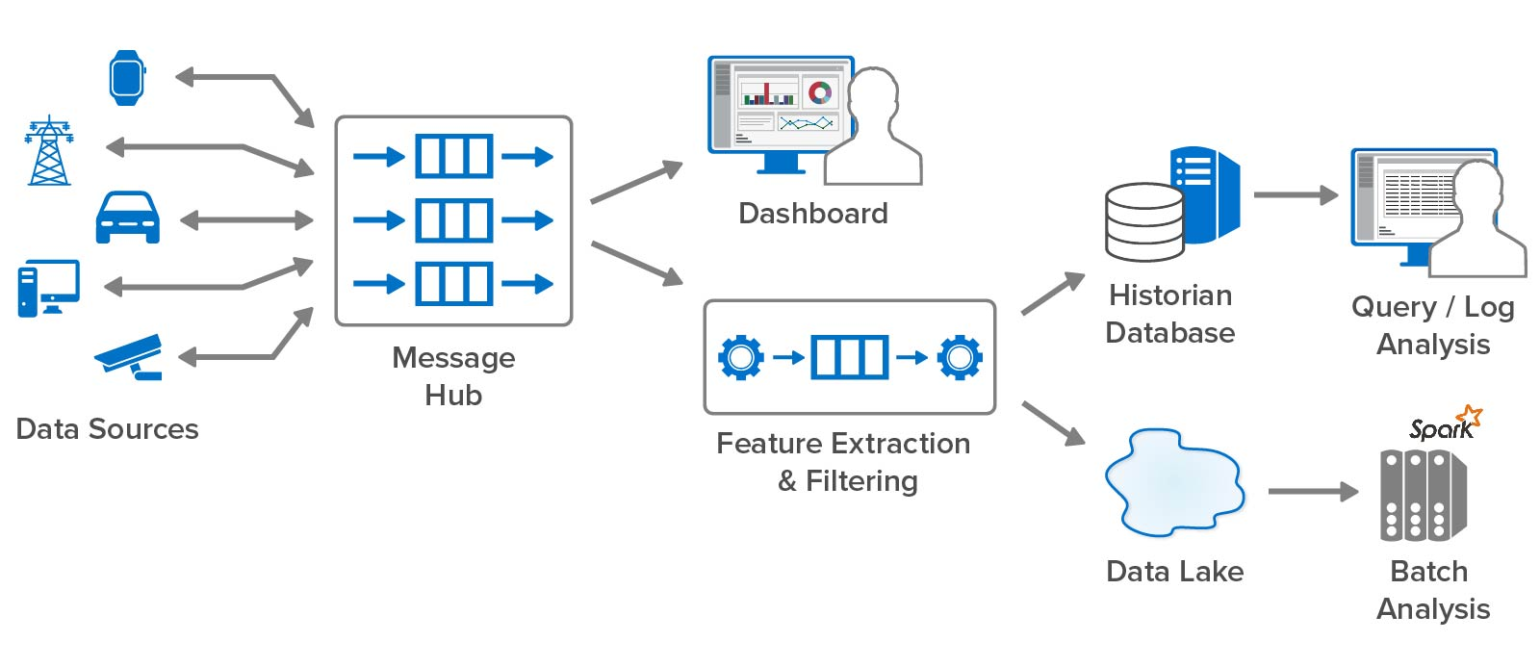
Today’s Streaming Analytics Platforms
Perform most analysis using back-end systems; respond in minutes or longer:
Messages arrive using a message hub (e.g., Kafka) for buffering and delivery.
Real-time streaming pipeline performs filtering and feature extraction.
Messages flow to historian database for query and log analysis.
Offline data lake performs batch analysis with big data tools (e.g., Spark).

Slide 9
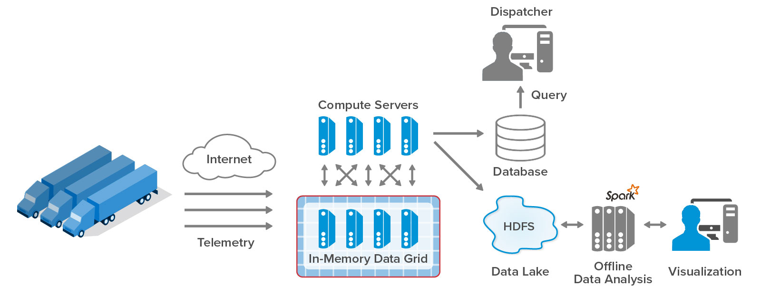
The Need for Granular Real-Time Analytics
Today’s streaming analytics do not:
Track data sources individually.
Perform aggregate analytics online.
As a result, they cannot:
Predict emerging issues for each data source.
See important trends in real time (seconds).
Typical Telematics Architecture for Streaming Analytics

Slide 10
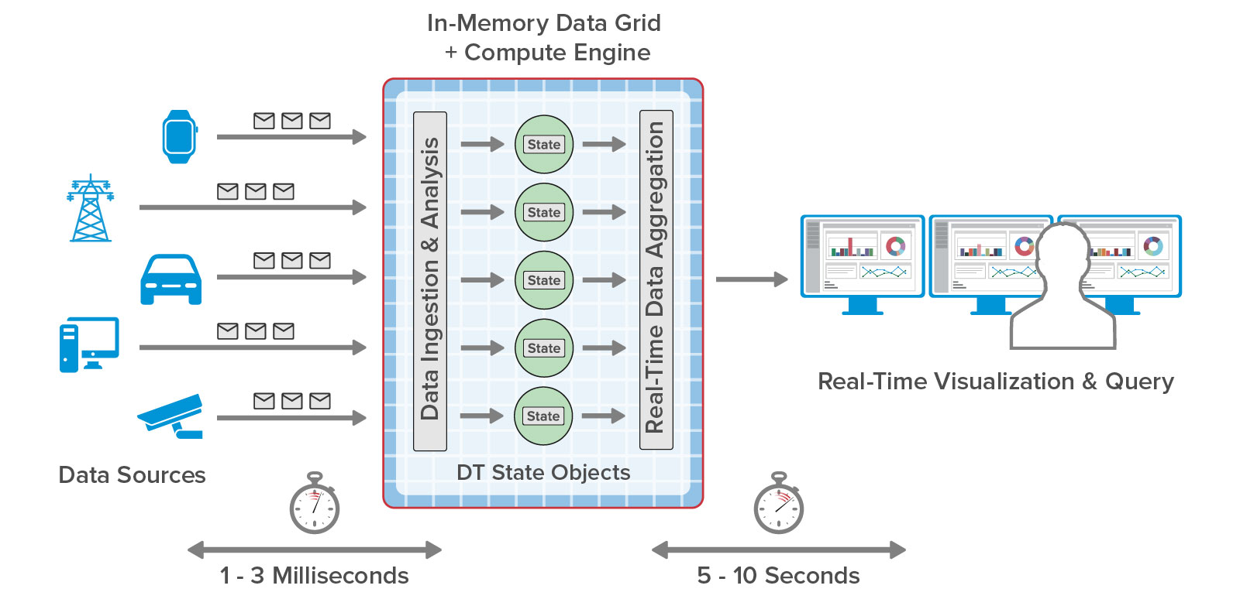
The Solution: Real-Time Digital Twins
A new in-memory technique for streaming analytics:
Separately analyzes telemetry for each data source.
Maintains dynamic state for each data source.
Key Advantages:
Introspects in real time on each data source.
Provides data for immediate aggregate analytics.
Transparently scales.
Continuous Analysis
Software Architecture Using Real-Time Digital Twins

Slide 11
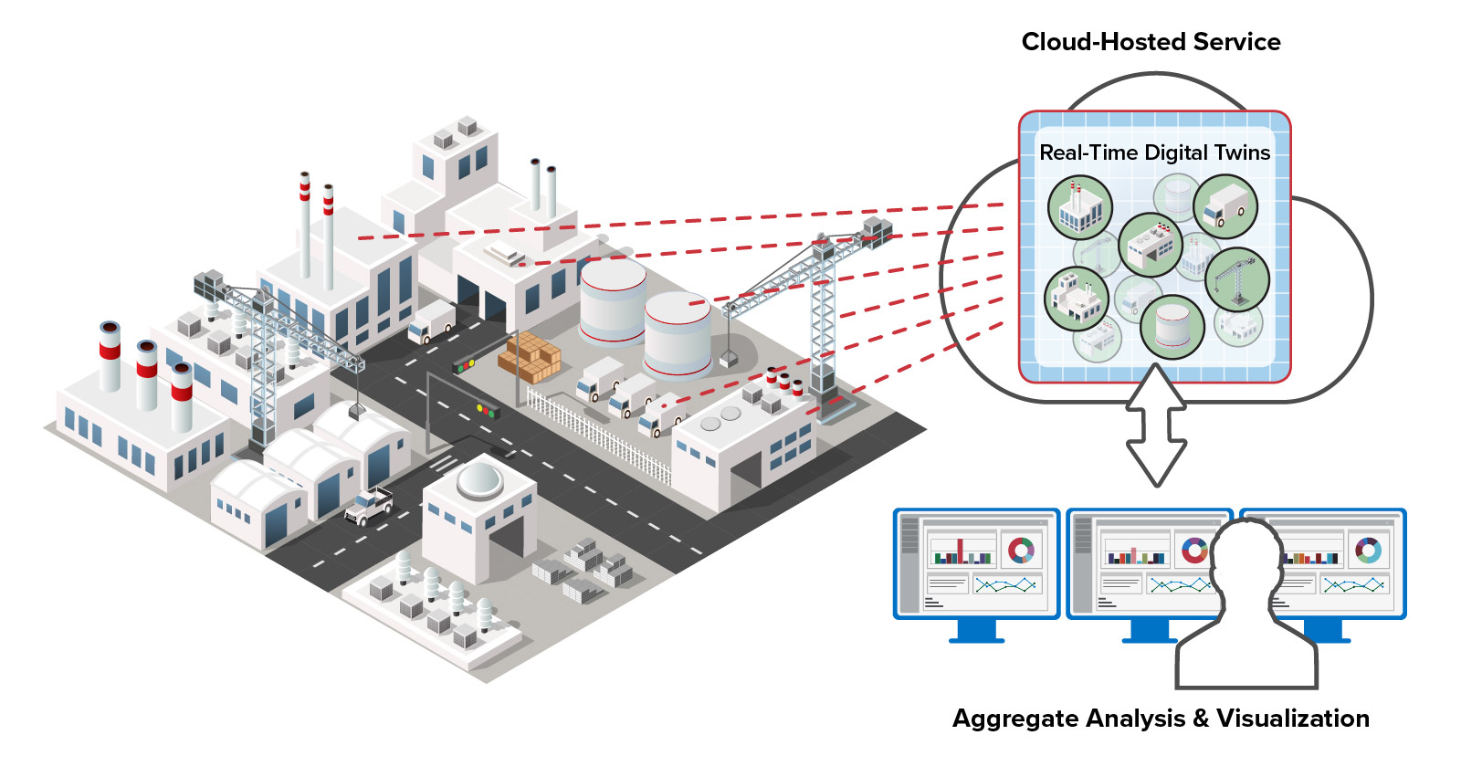
Benefits of Real-Time Digital Twins
Faster responses: Continuously analyzes incoming telemetry.
Deeper introspection: Tracks and updates information about each data source.
Better situational awareness: Continuously aggregates & visualizes derived state.
Transparently scalable: Seamlessly scales using in-memory computing.
Easy to use: Uses simple, object-oriented APIs.

Slide 12
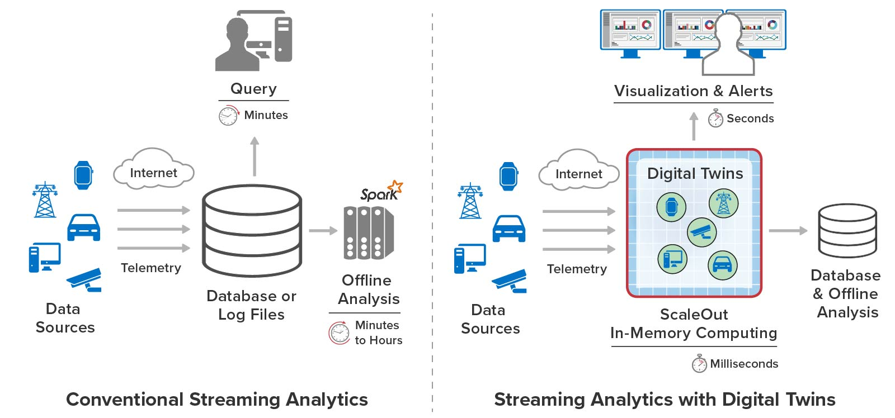
Comparison to Conventional Techniques
Real-time digital twins immediately extract useful information, generate alerts, and visualize emerging trends:

Slide 13
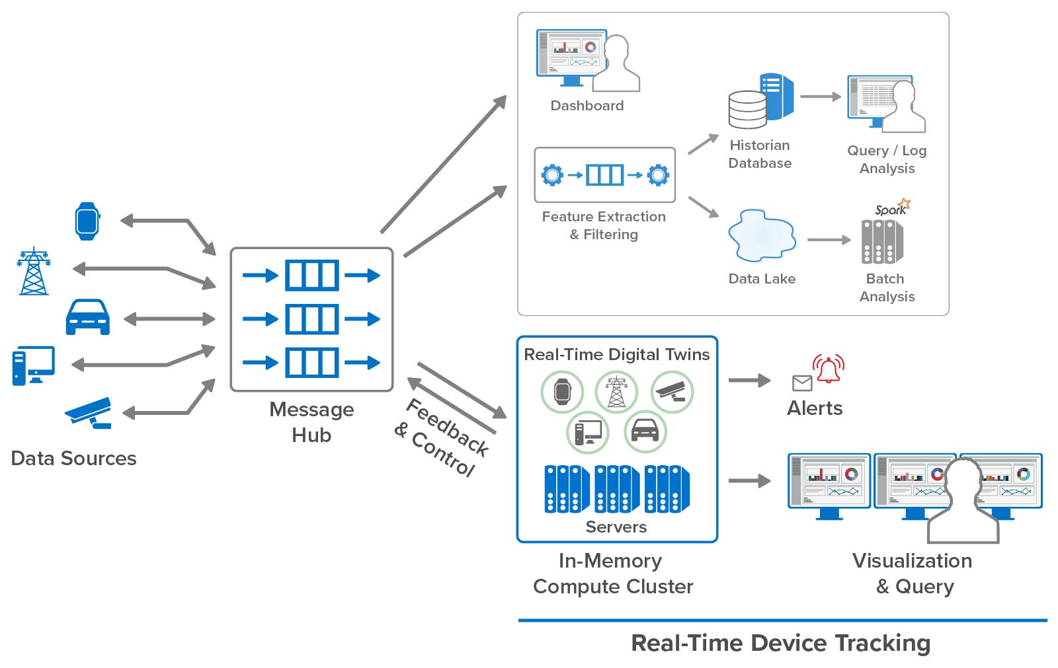
Run Alongside Existing Analytics
Complements existing streaming platforms.
Runs alongside existing components.
Adds real-time tracking for each device.
Enables alerts and feedback to the device in milliseconds.
Enables real-time aggregate analysis.
Runs on a scalable compute cluster which:
Hosts device state
Runs analytics code

Slide 14



A New Vision for Digital Twins
A digital twin is a virtual representation of real-world entities and processes, synchronized at a specified frequency and fidelity. … Digital twins use real-time and historical data to represent the past and present and simulate predicted futures. … -- as defined by the Digital Twin Consortium
Designing a Jet Engine
Digital twins were conceived to help design and test complex new devices (PLM).
More recently, operational digital twins are used in small numbers to track telemetry in production for preventative maintenance.
The next step: use large collections of digital twins to track systems with many data sources:
Vehicle fleets
Logistics systems
Large infrastructures
Ecommerce shoppers
Monitoring an Industrial Robot
Tracking the US Railway System

Slide 15
Our Focus
We are not developing digital twin models for PLM. Our goals are to:
Use digital twins for real-time monitoring and simulation:
Per-device streaming analytics enriched with context
Simulation for predictive modeling and workload generation
Focus on large systems with many devices.
Develop open-source APIs to catalyze development using digital twins.
Leverage scalable, in-memory computing technology to:
Track/model thousands of devices.
Provide fast responses and scalable throughput.
Combining a software model and in-memory computing is the key.

Slide 16
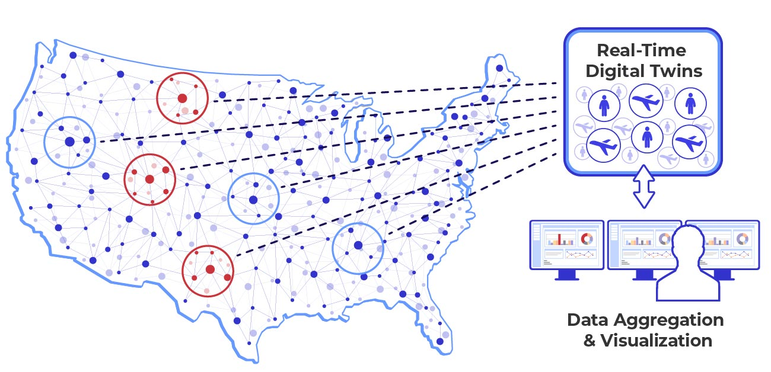
Digital Twins Enable Aggregate Analysis
Simultaneously analyzes the state of all digital twin instances to identify and visualize widespread trends in real time.
Boosts situational awareness.
Some examples:
Offer flash sale to individual online shoppers and tweak it in real time by tracking overall impact.
Monitor power stations and identify rolling blackout.
Track a rental car fleet and alert all drivers vehicles approaching an unplanned road closure.
Identify an emerging pattern of fraudulent wire transfers.

Slide 17
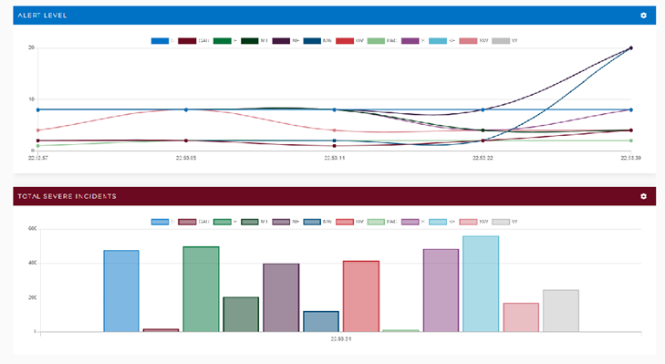
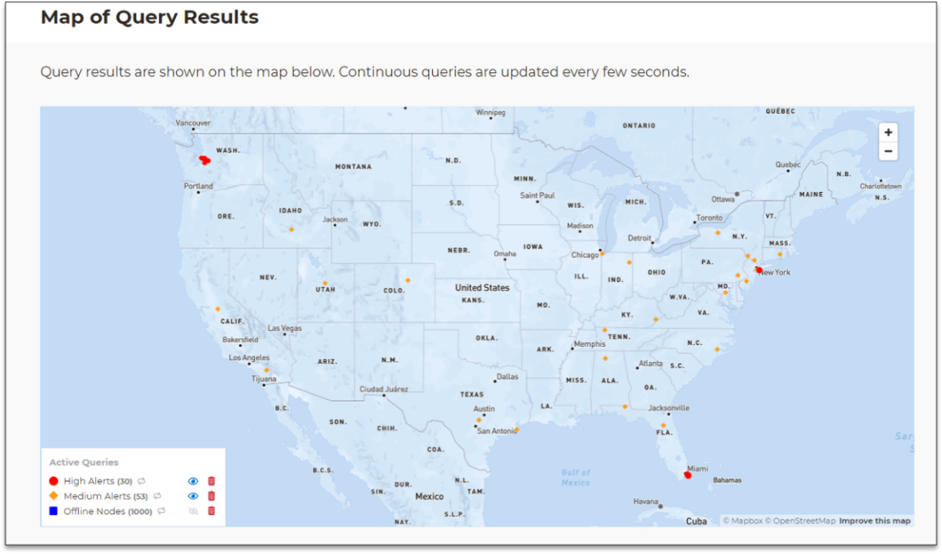
How Real-Time Aggregate Analysis Works
Aggregates and visualizes selected state information from all digital twins every 5-10 secs.
Boosts situational awareness:
Helps pinpoint multiple issues across data sources.
Enables fast creation of a strategic response.
Example of a Widget
Example of Continuous Geospatial Query

Slide 18
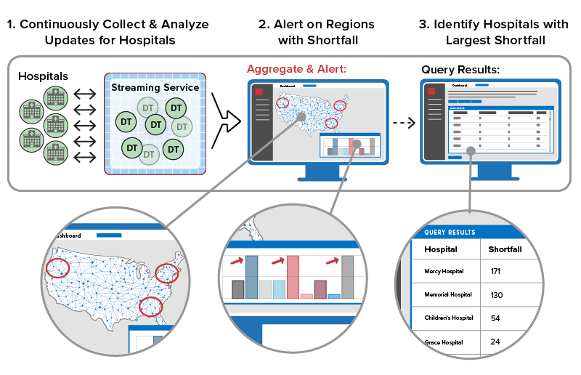
Example of Aggregate Analytics & Query
Maximizes situational awareness for a logistics application:
Aggregate analytics combines key digital twin data in seconds.
Example: Determine largest shortfall in hospital supplies by region.
Widgets lets users visualize results.
Example: Show shortfall by region as a bar chart to alert on problem areas as they occur.
Users query digital twin data to identify issues and take action.
Example: Query digital twins to find specific hospitals with largest shortfall in affected regions.

Slide 19
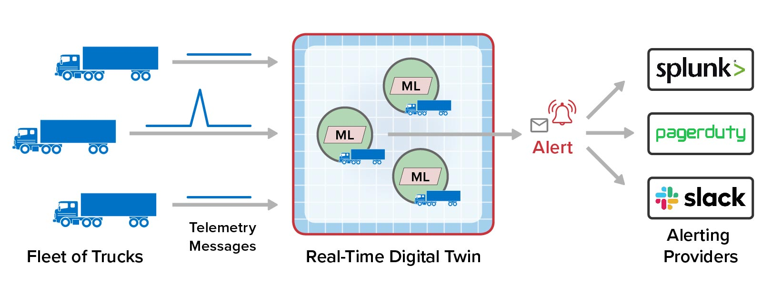
Optional Machine Learning Adds Power
Digital twins can run machine learning algorithms to analyze telemetry from data sources:
Performs spike, trend, and anomaly detection and send alerts with no code required.
Finds emerging issues in cases where ML has advantage over coding.
Runs separately for each data source in each real-time digital twin.

Slide 20
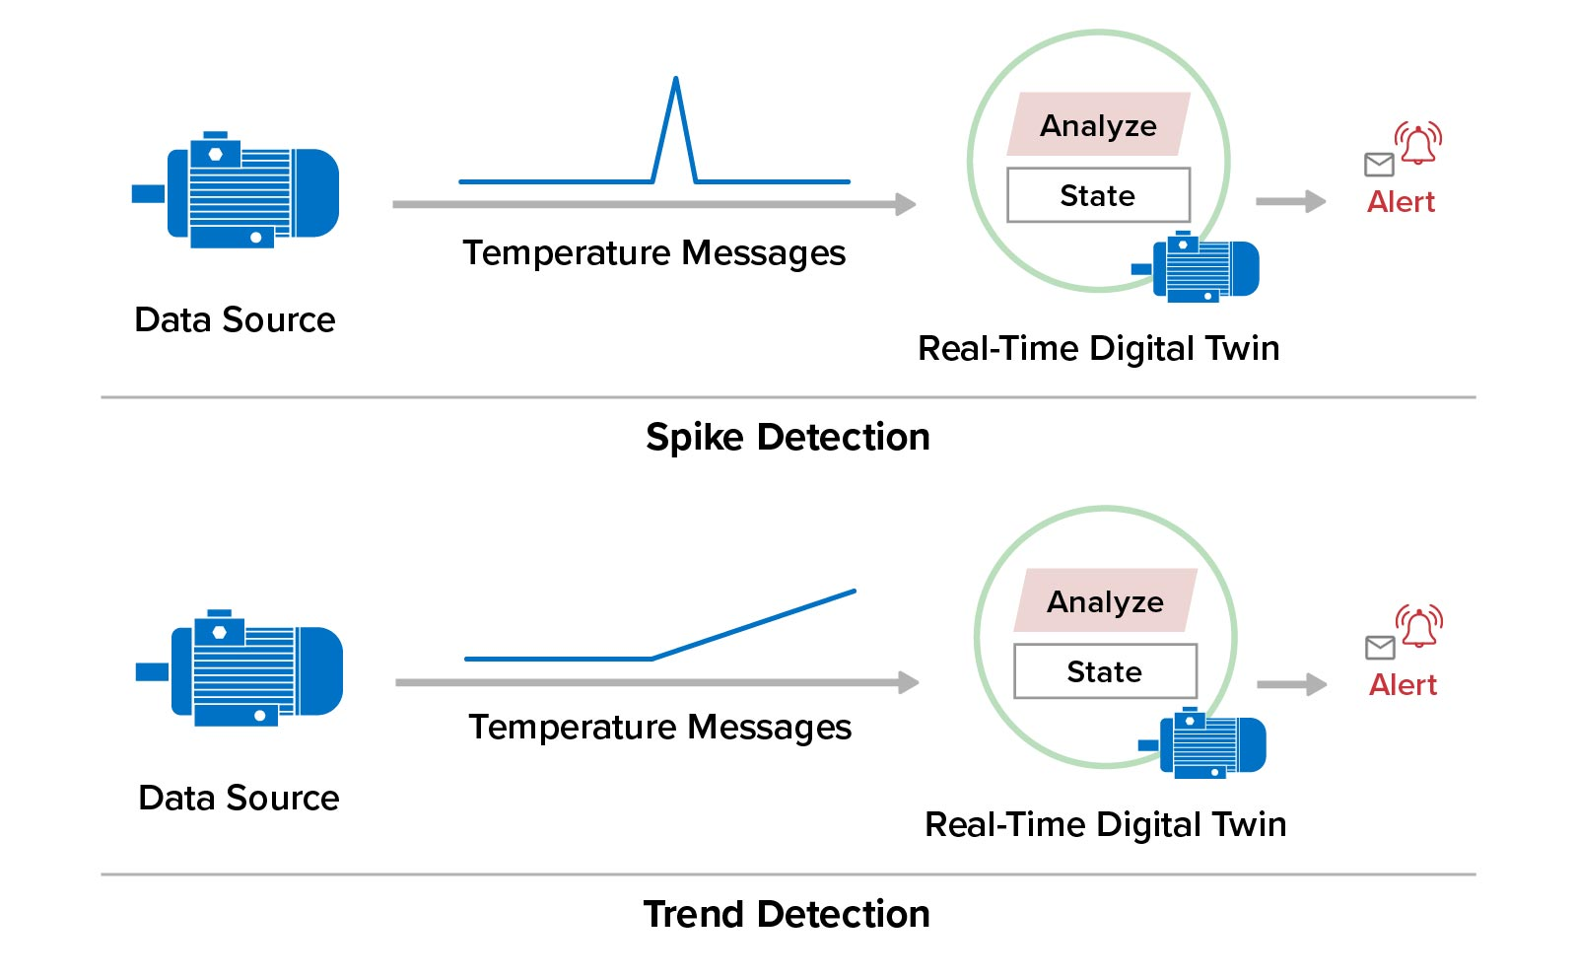
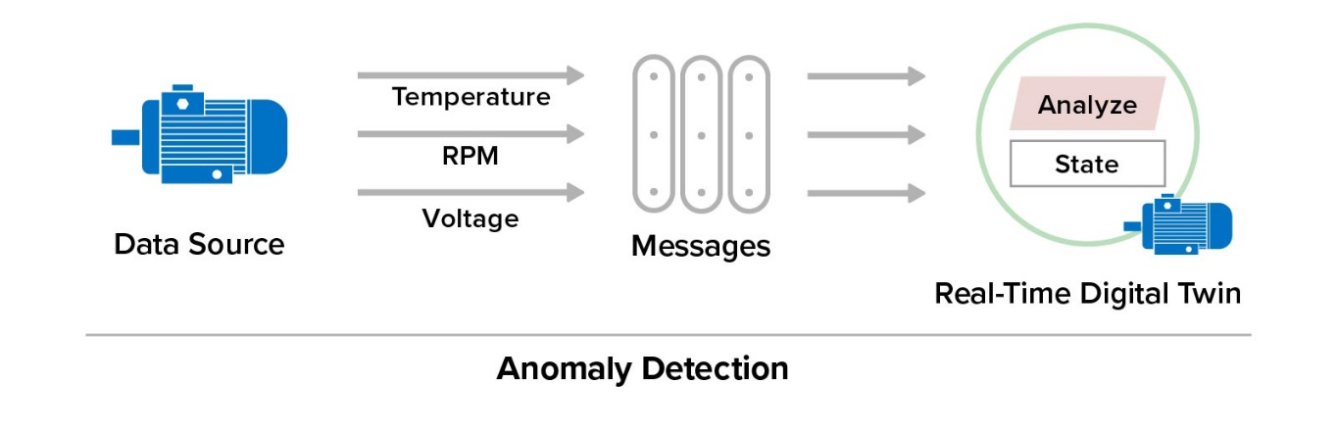
Machine Learning Capabilities
Examples of ML include spike, trend, and multi-parameter anomaly detection:

Slide 21
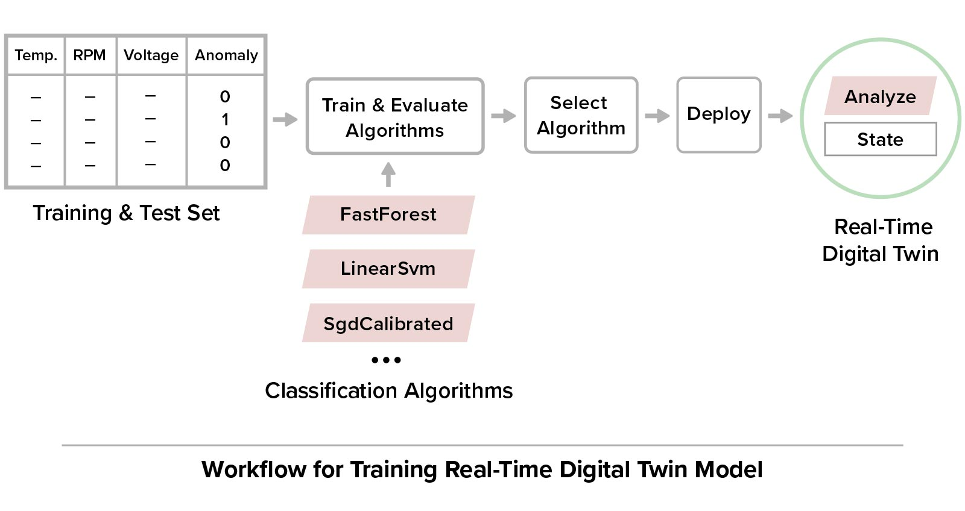
Training Anomaly Detection
Anomaly detection uses binary classification algorithm trained with user’s data set:
User can train and evaluate multiple ML algorithms.
User selects one algorithm based on metrics from training.

Slide 22
Many Use Cases for Real-Time Monitoring
Here are some use cases for digital twins tracking and modeling complex live systems:
Telematics – vehicle fleets
Transportation safety – railroads
Transportation systems – help manage passengers and assets for an airline
Logistics –tracking shipments
Disaster recovery –tracking wildfires and alerting personnel
Security – tracking physical and cyber security perimeters
Crime prevention – cloned license plate and convoy detection
Fraud detection – credit card fraud
Health informatics – tracking with wearable devices
Smart cities and building management

Slide 23

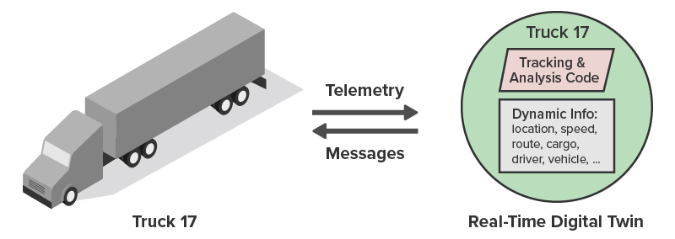
Example: Fleet Telematics
Real-time tracking for a car/truck fleet (typically, thousands of vehicles)
Telemetry includes location, speed, mechanical & cargo parameters.
Digital twins add route, cargo, info on driver, service history & issues, weather, etc.
Using incoming telemetry, digital twins can:
Alert driver to upcoming hazardous road conditions or weather delays.
Assist lost driver or alert if driving too long or unsafely.
Track emerging mechanical issues with vehicle or risk to cargo.
Maintain status which can be aggregated for all trucks to enhance dispatcher’s situational awareness of the fleet.

Slide 24

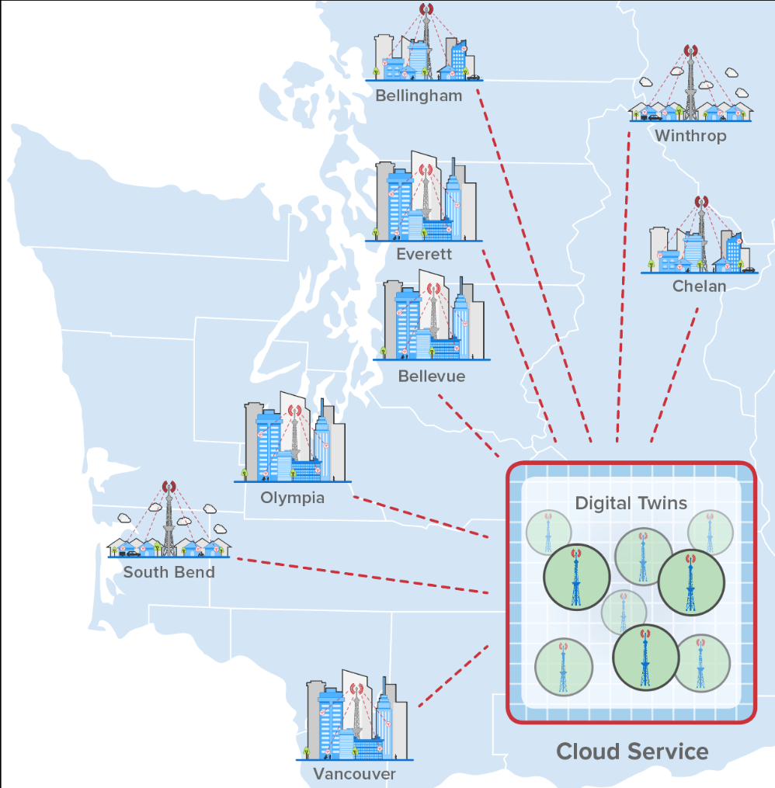
Example: Disaster Recovery
Goal: help find buried survivors after an earthquake using their cell phone data.
How?
5G cell towers can track direction and signal strength for each subscriber.
This information can help locate survivors.
There are about 350K 5G cell sites in the U.S.
Digital twins can maintain current status of all cell towers.
Can track fast-changing updates to call status for each cell tower.
Aggregate analytics can immediately pinpoint areas of greatest need.

Slide 25
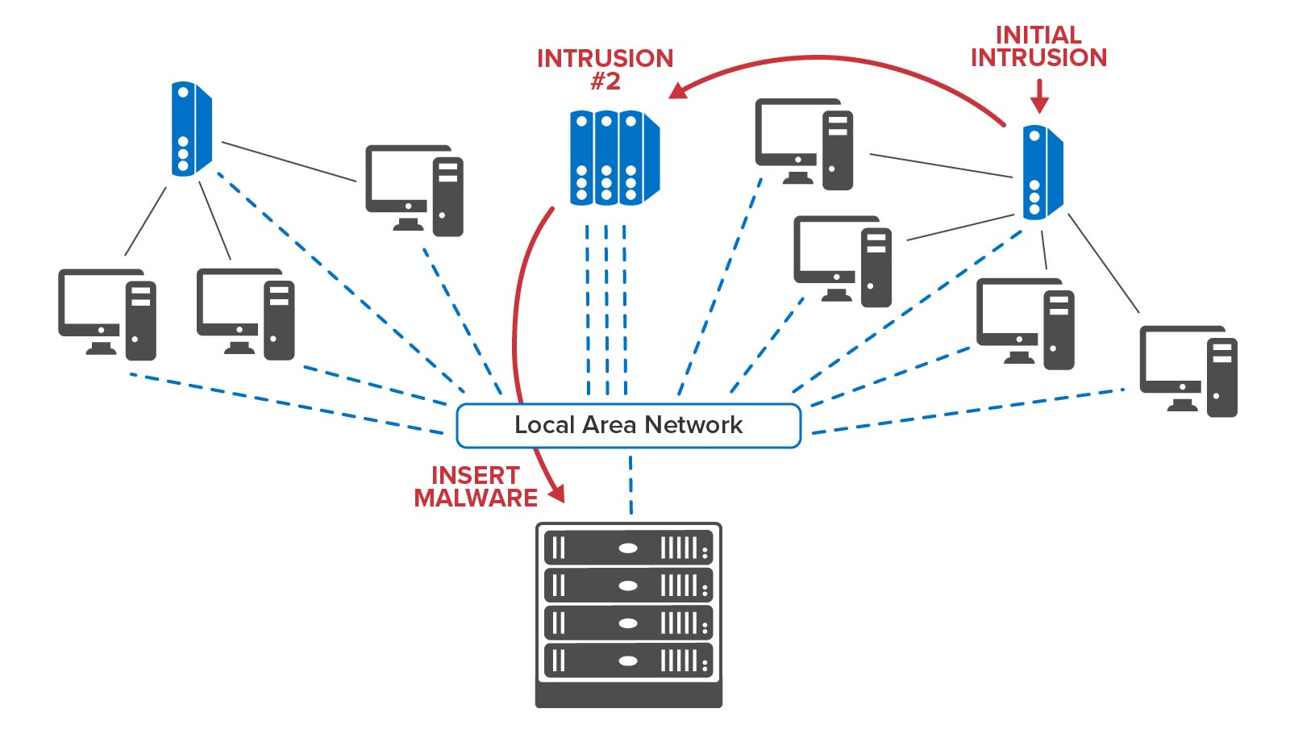
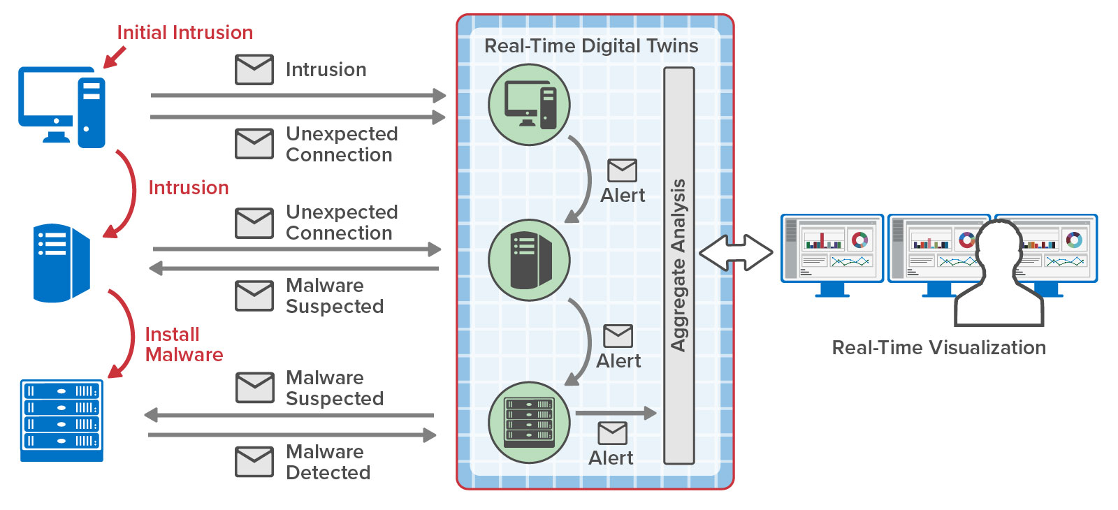
Example: Cybersecurity
Real-time digital twins can be used to:
Track the evolving state of entry points and assets (e.g., desktops, routers, servers).
Display the dynamic state of assets, not just events in SIEM consoles.
Track (with ML) and possibly stop the progress of an intruder within an infrastructure.
Example of a Cyber “Kill Chain”
Use of RTDTs to Interrupt Intruder’s Progress

Slide 26
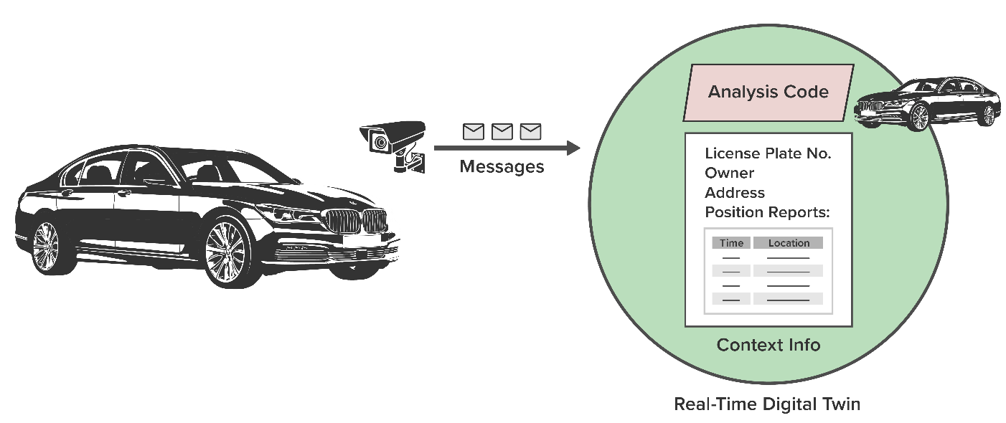
Ex.: Detecting License Cloning & Convoys
Real-time digital twins can track movement of vehicles to identify cloned license plates and convoys.
ScaleOut in-memory computing (IMC) platform creates a real-time digital twin (RTDT) for each vehicle:
RTDT holds key information about vehicle (owner, home address, license number).
RTDT receives and holds position reports from CCTV cameras on roads.
With each position update, RTDT runs analytics code to detect possible cloning or convoys and alert authorities within seconds.
Example of cloning detection algorithm:
Identify successive position reports with unusually large distance change or unlikely locations.

Slide 27
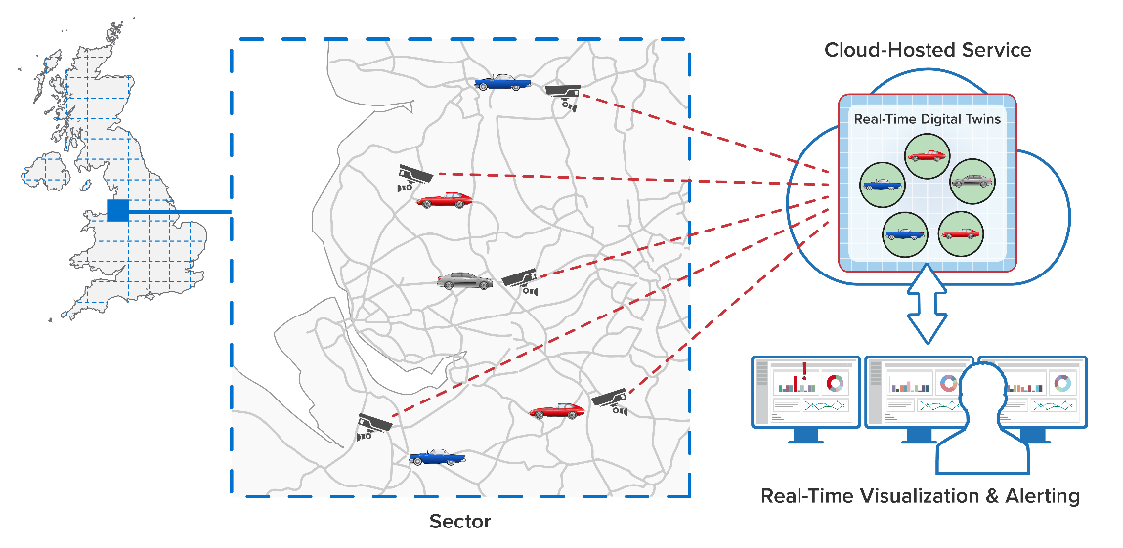
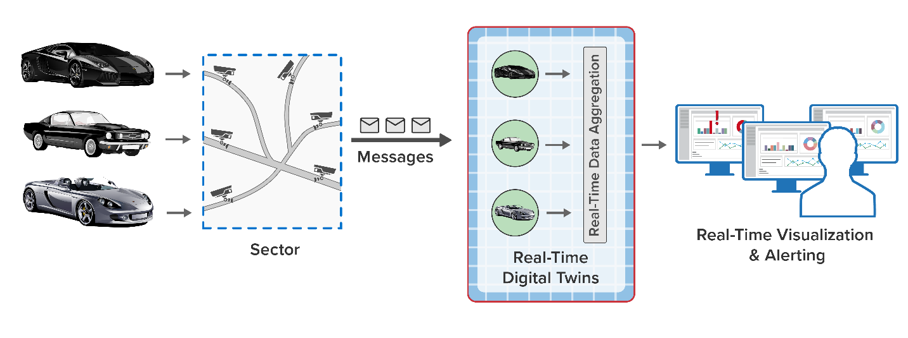
Convoy Detection Using Digital Twins
IMC platform divides country into sectors and locates vehicles within sectors using CCTV cameras which feed position reports to cloud-hosted service.
As real-time digital twins detect a vehicle’s entry into a sector, they compare position reports with those for other vehicles:
Matching routes and times, especially over multiple roads, indicate a suspected convoy.
Matching routes and times with suspected (known) lead vehicle reinforce suspicion.
Overall System Architecture
Comparing Position Reports within a Sector

Slide 28

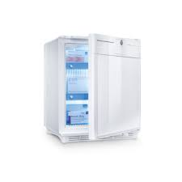
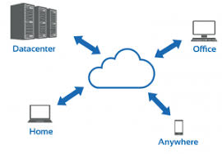
Example: IoT for Medical Refrigerators
Sep 26, 2019
Cloud-based streaming service monitors 10,000+ medical refrigerators:
Refrigerators hold highly important tissue samples, embryos, etc.
Service receives periodic telemetry:
Temperature
Power consumption
Door position, etc.
Must predict failure before it occurs:
Notify user to migrate contents to another refrigerator.
Avoid false positives.
Identify widespread power outages (aggregate analytics).

Slide 29
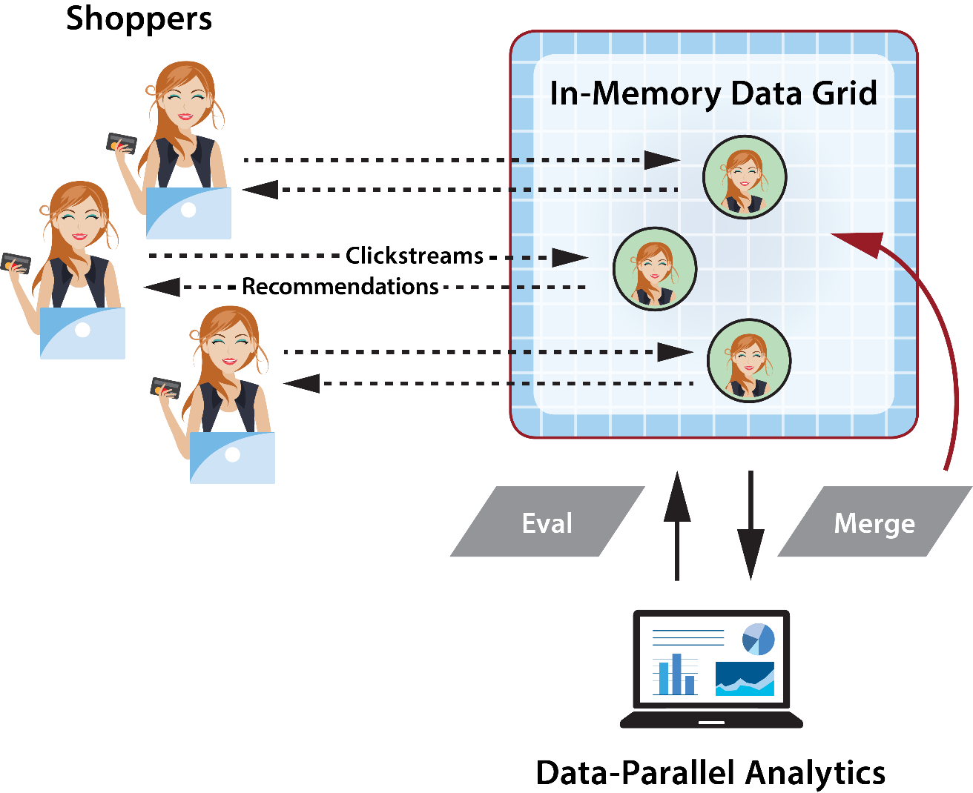
Example: Ecommerce Recommendations
Ecommerce site may have 100k+ shoppers, each generating a clickstream.
Digital twin for each shopper:
Maintains a history of clicks, shopper’s preferences, and purchasing history.
Analyzes clicks to create new recommendations in real time.
Aggregate analysis:
Determines collaborative shopping behavior, basket statistics, etc.
Enables targeted, real-time flash sales.

Slide 30
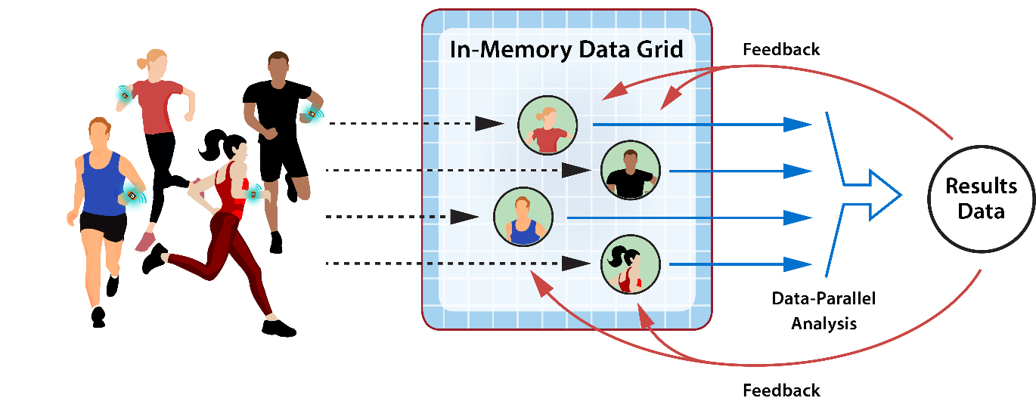
Example: Personalized Health Tracking
Real-time digital twins analyze telemetry from health-tracking devices to help ensure wearer’s safety and give feedback:
RTDTs receive periodic messages with key metrics (heart rate, blood oxygen, etc.).
RTDTs track person’s health history, medications, limitations, recent medical events.
Data-parallel analysis combines dynamic results from large populations for feedback.

Slide 31
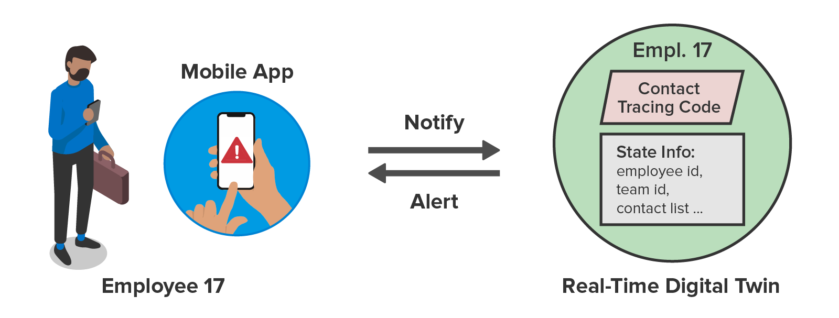
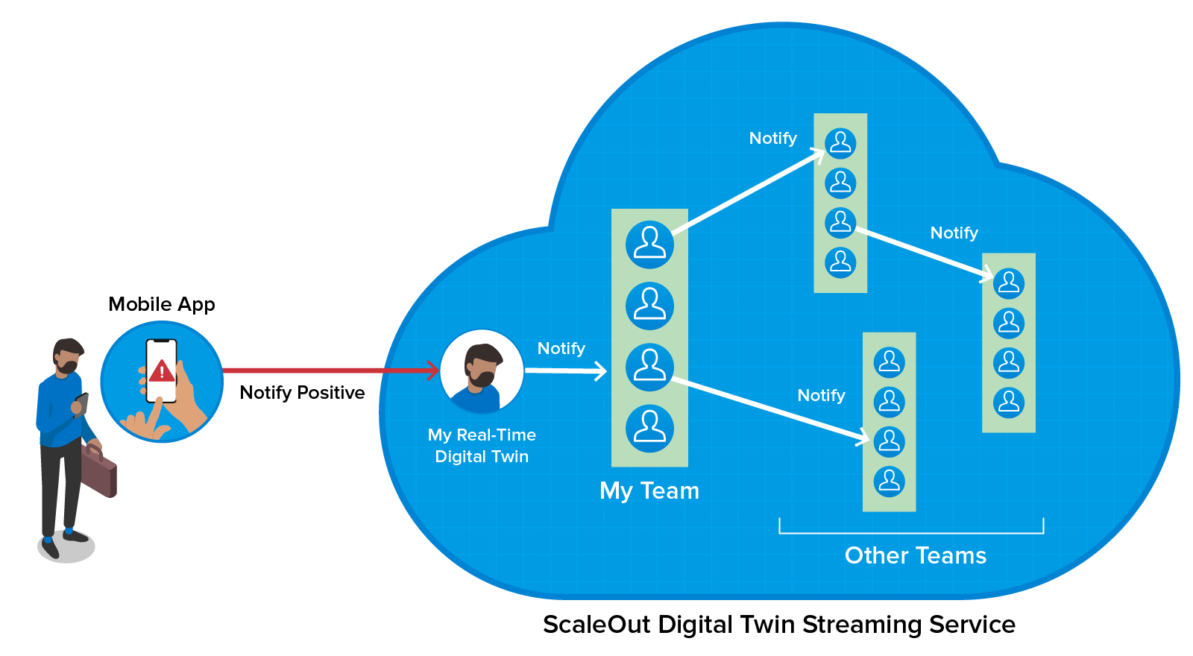
Example: Contact Tracing
Cloud service tracks employees, creates notifications, and provides real-time aggregate statistics.
A real-time digital twin instance tracks each employee:
Keeps list of contacts.
Signals other digital twins when employees tests positive.
Digital twins traverse network of contacts within seconds.
Each signaled twin alerts its employee.
Twins maintain statistics for aggregate analysis.

Slide 32

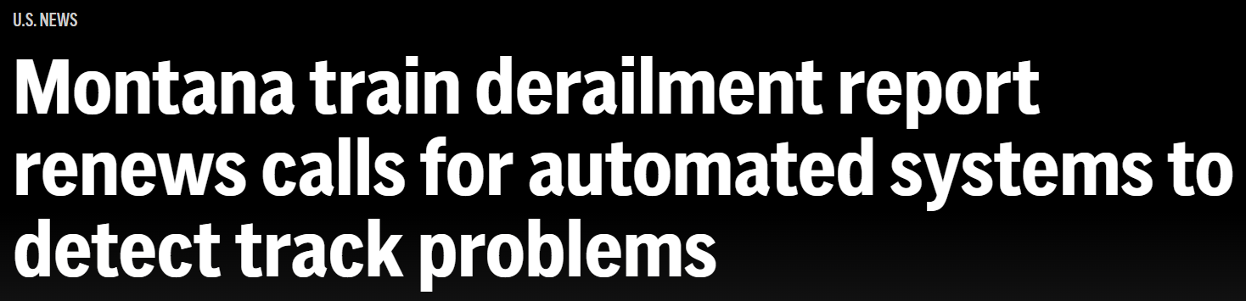
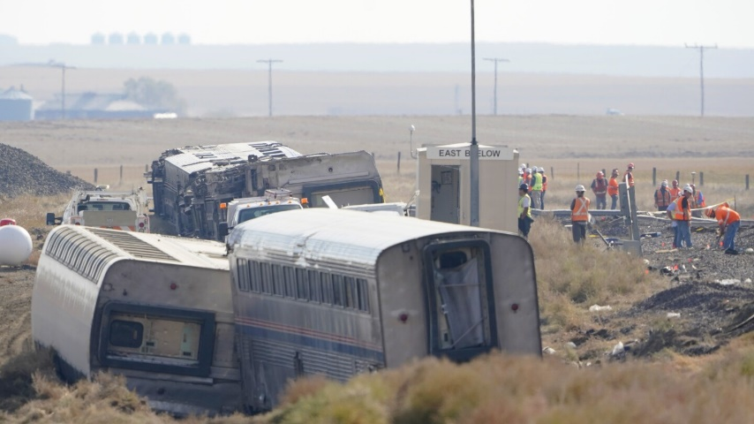
Example: Tracking the Freight Rail System
Each year in the US, thousands of freight trains carry 1.6 billion tons of freight across 140,000 miles of track:
Approx. 300 trains per week
Approx 500K carloads per week
In 2022, there were more than 1,100 train derailments, causing over 100 million dollars in damage.
6,000 hot boxes around the US monitor the temperature of wheel bearings, which can cause derailments if they get too hot.
Hot boxes just alert operators by radio when high temperature is detected; they do not track trends.
Digital twins can solve this problem:
Track and analyze temperature trends for all wheel bearings.
Integrate service history and other relevant data to assess danger and create timely alerts.
July 28, 2023

Slide 33
VIDEO: Preventing Train Derailments
https://youtu.be/9IDrjZEVN2I

Slide 34
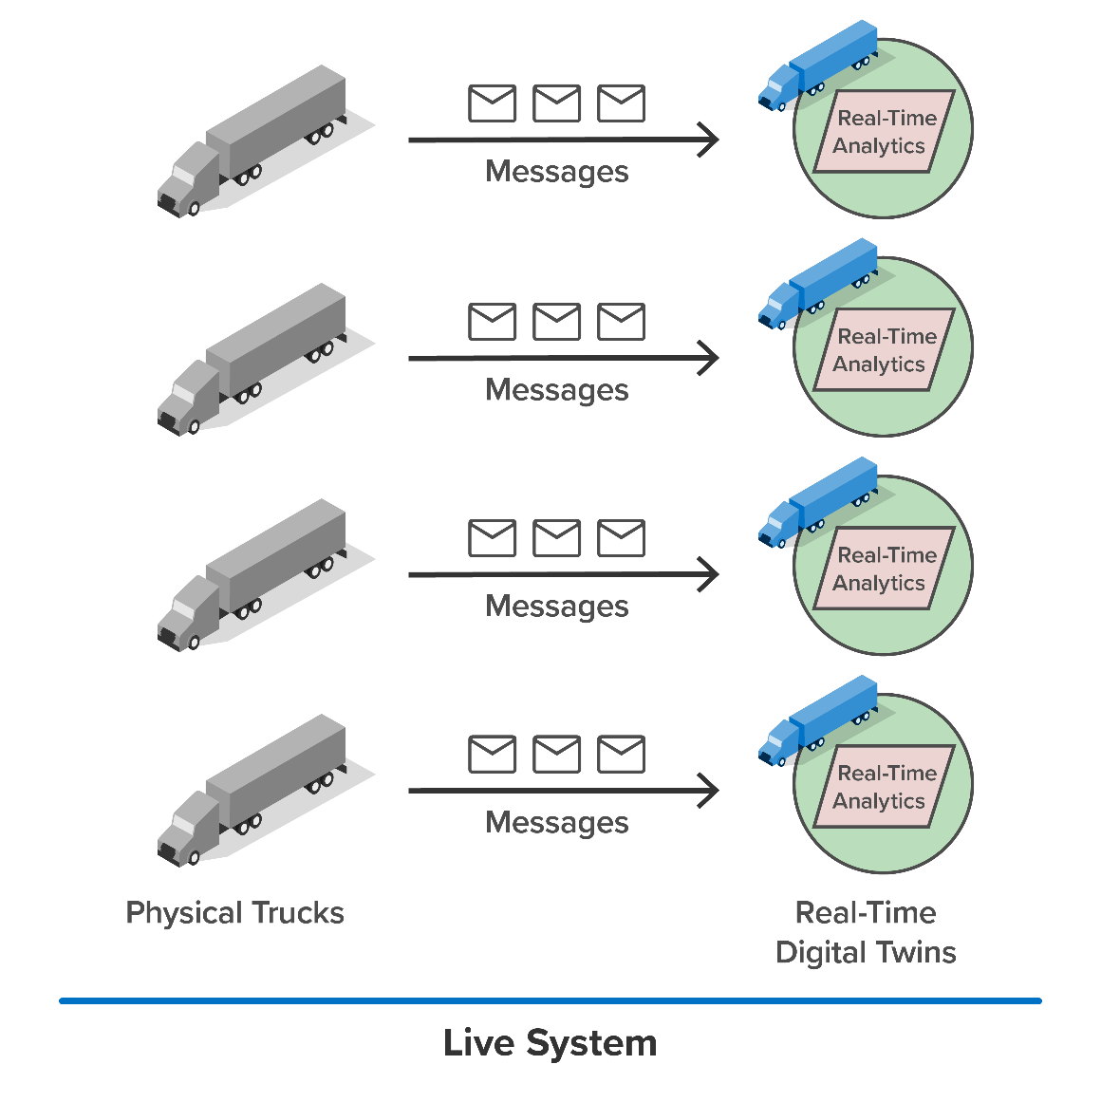
Use Digital Twins for Simulation
Digital twins simplify the construction of large-scale simulations (1000s to millions of interacting entities).
One use case: a workload generator for testing streaming analytics.
Key benefits:
Allows testing and validation prior to deployment.
Simplifies application design.
Enables seamless scaling to model large systems.

Slide 35
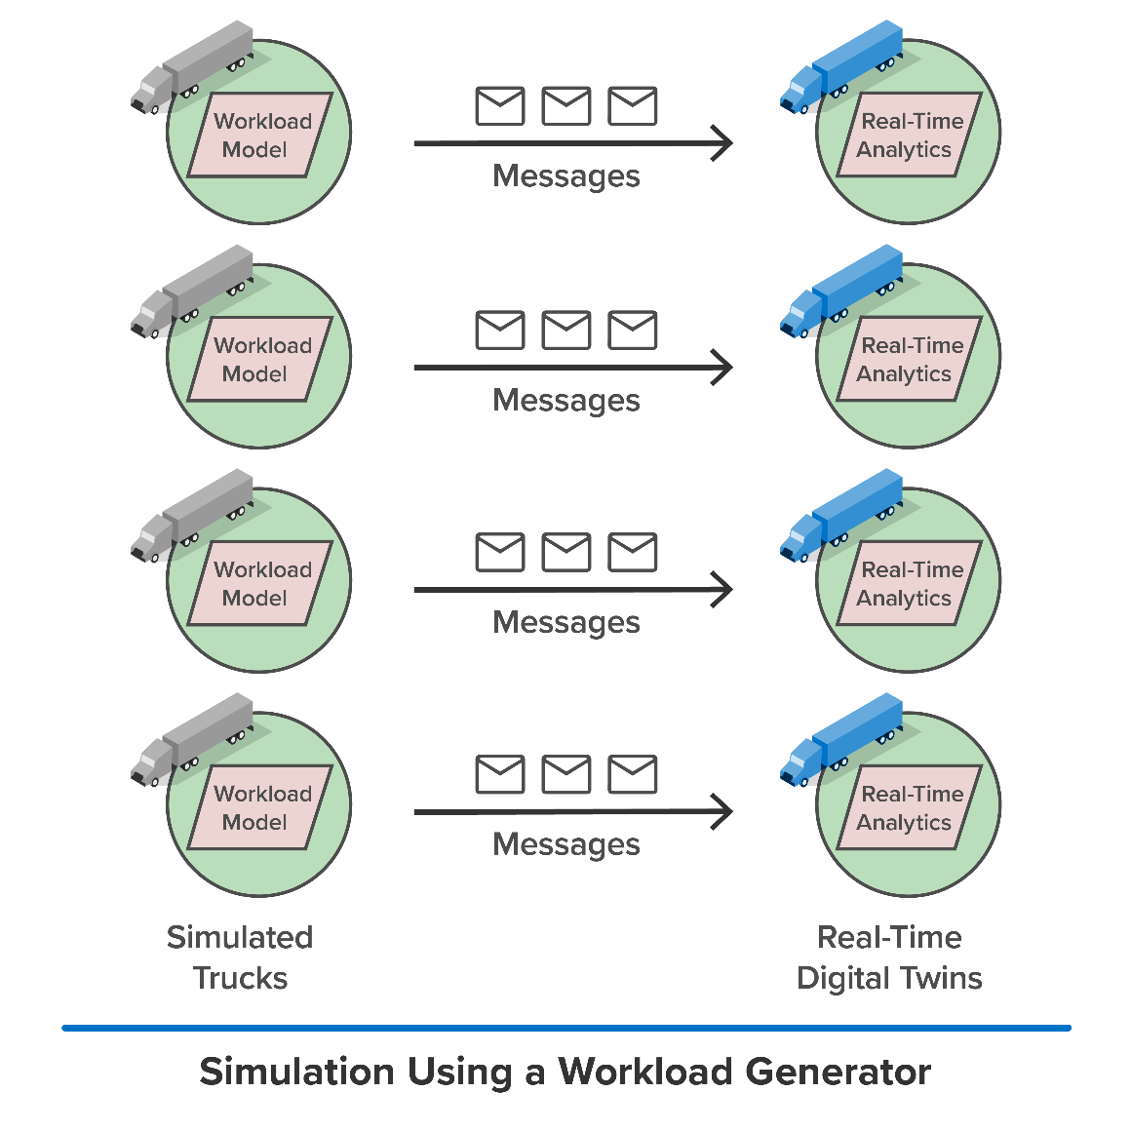
Use Digital Twins for Simulation
Digital twins simplify the construction of large-scale simulations (1000s to millions of interacting entities).
One use case: a workload generator for testing streaming analytics.
Key benefits:
Allows testing and validation prior to deployment.
Simplifies application design.
Enables seamless scaling to model large systems.

Slide 36
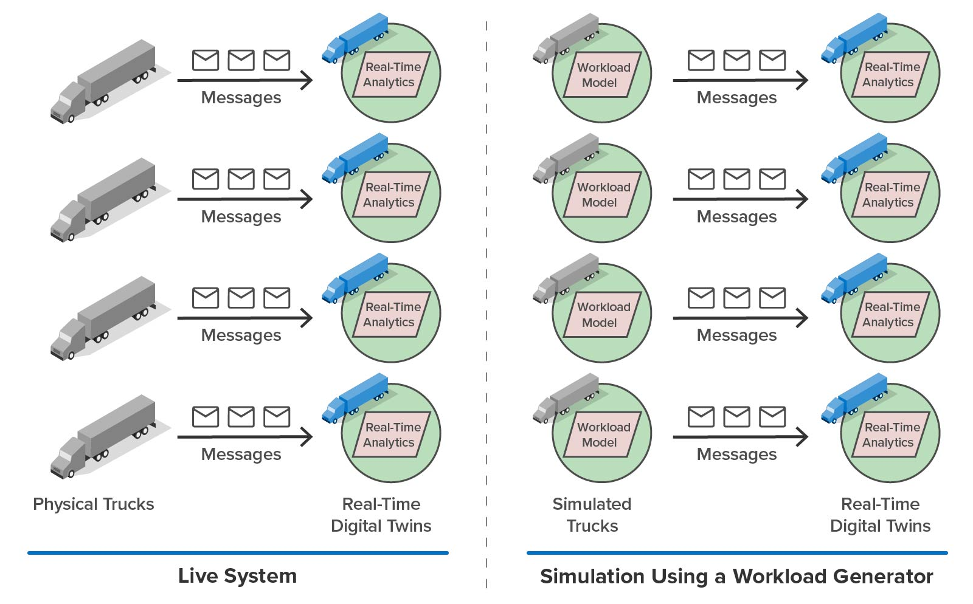
Using Simulation to Validate Streaming Analytics
Digital twins can model live data sources:
Generate telemetry in simulation and send it to real-time digital twins.
Real-time digital twins can implement streaming analytics.
Simulation validates streaming analytics in a variety of scenarios.
Real-time digital twins can then be deployed to analyze live telemetry.
Telematics Simulation

Slide 37
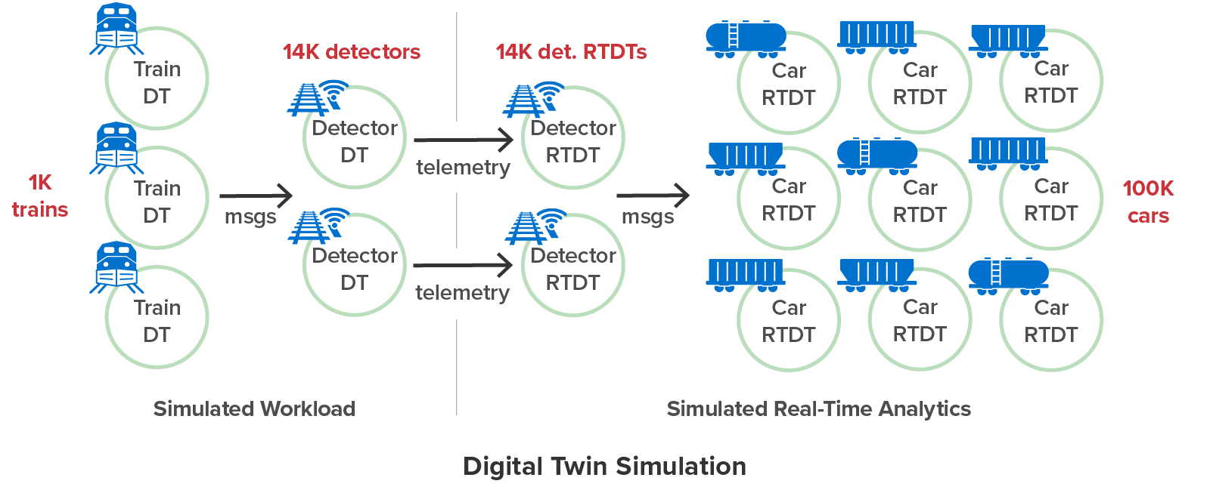
Example: Modeling the US Railway System
Goal: Simulate telemetry tracking from track-side detectors and predict axle failures before an accident can occur.
Uses digital twins to both model the system and implement real-time analytics.
Demonstrates the scale needed to create a realistic simulation (~129K digital twins).

Slide 38


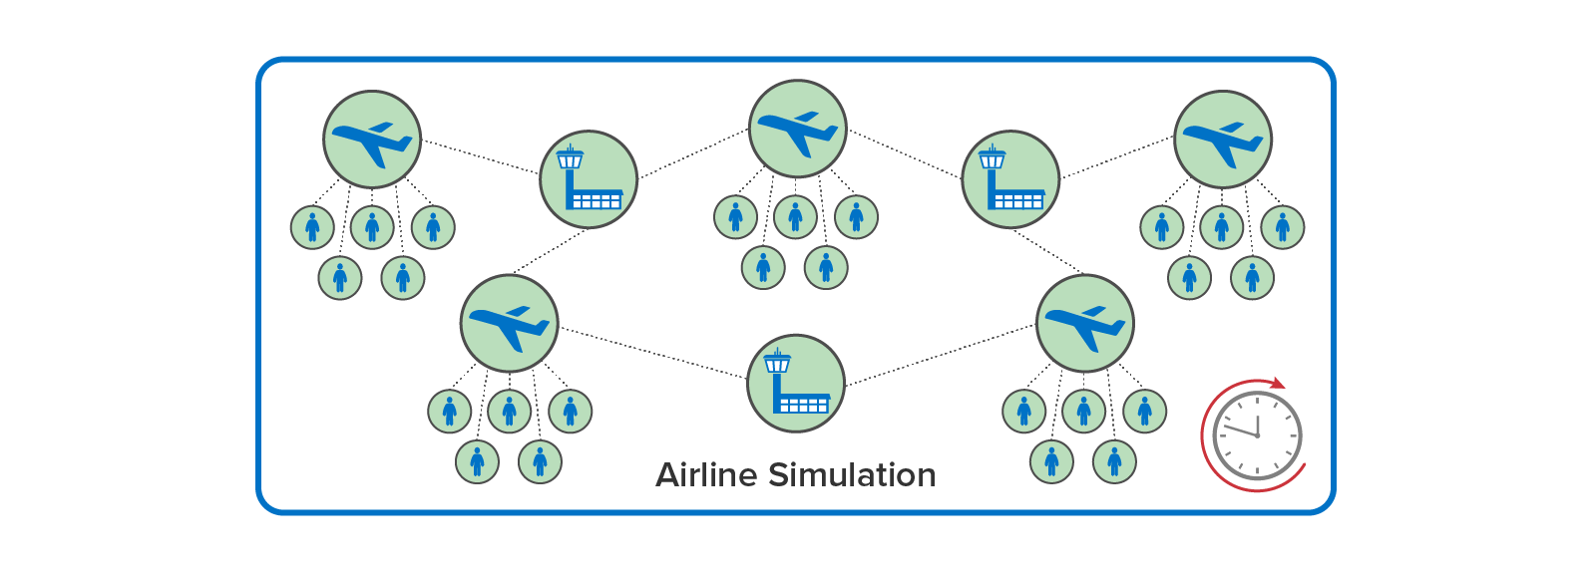
Another Simulation Use Case
Build system simulations with interacting digital twins exchanging messages for predictive modeling and decision-making.
Example: an airline system simulation
Use digital twins to model physical entities:
Airplanes, passengers
Airports, gates, etc.
Model and measure complex interactions.
Evaluate management decisions faster than real time.
Enable improved flying experience.

Slide 39
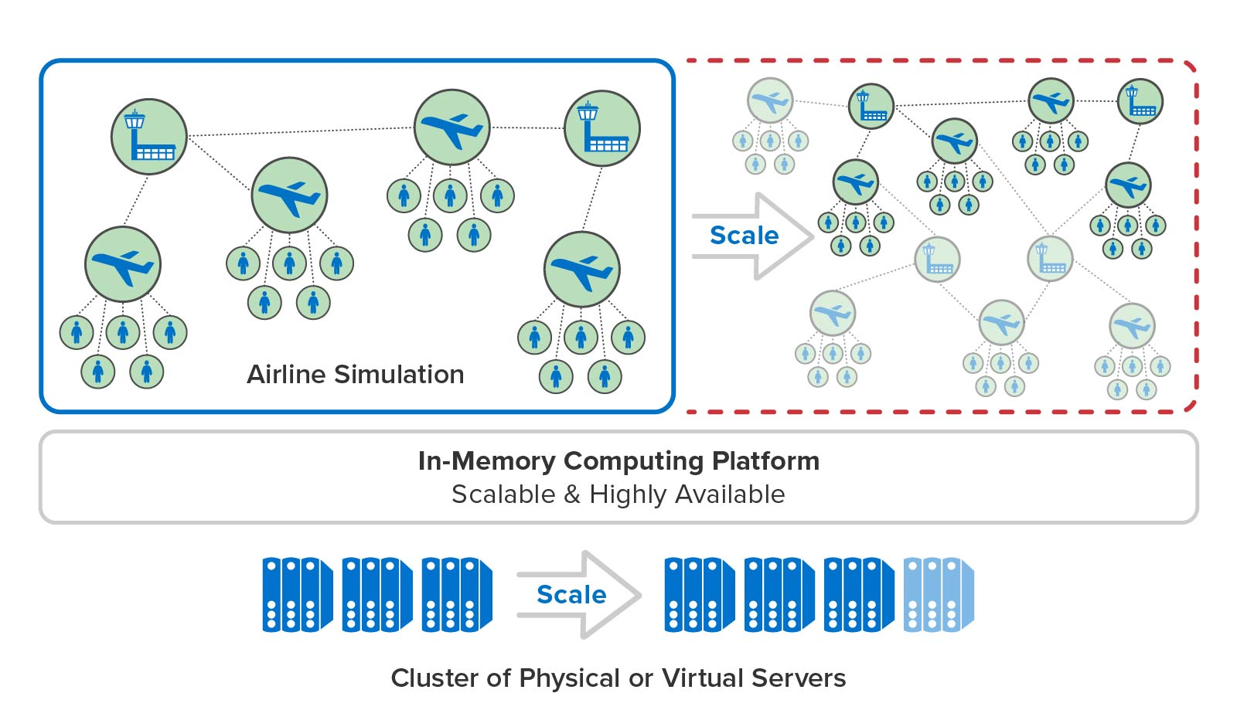
Running the Simulation at Scale
Digital twins:
Enable the construction of large-scale simulations (1000s to millions of interacting entities).
Leverage the power of in-memory computing.
Key benefits:
A tool for making design choices
Ability to make predictions for live systems
Improved decision making for managing complex systems
Airline Simulation

Slide 40
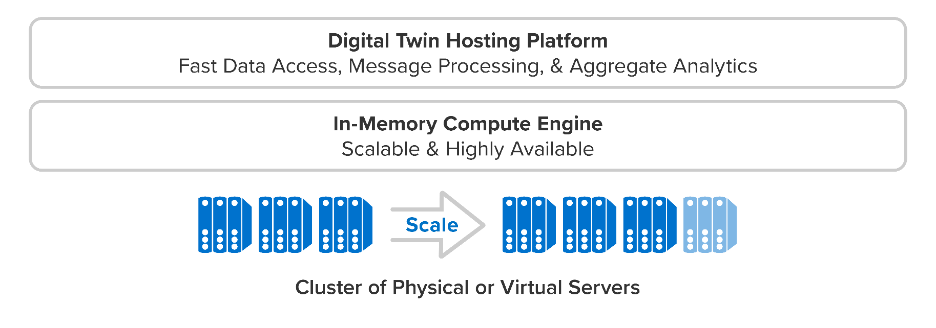
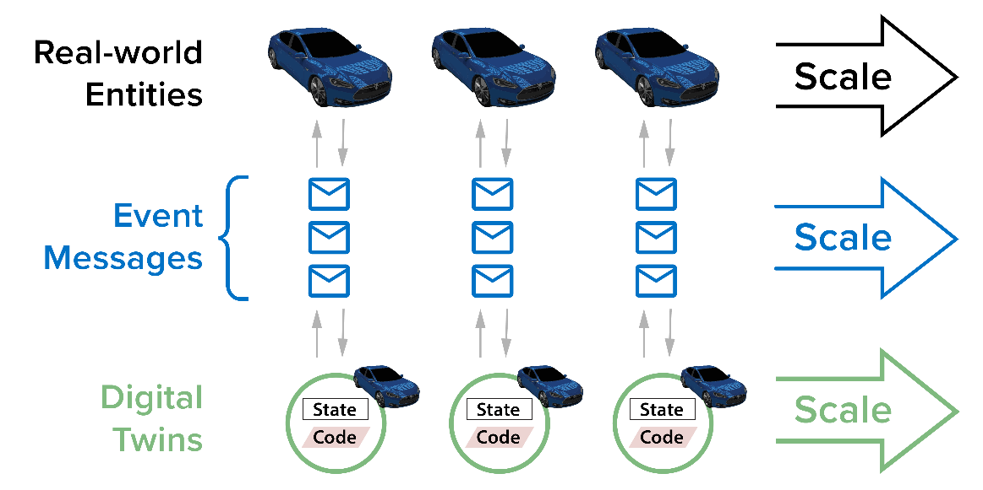
Benefits of In-Memory Computing
What is “in-memory computing”?
A scalable platform for hosting in-memory objects with integrated aggregate analytics
Transparent message processing, load-balancing, scaling, and high availability
Scales to host large populations of digital twins for both stream processing and simulation

Slide 41
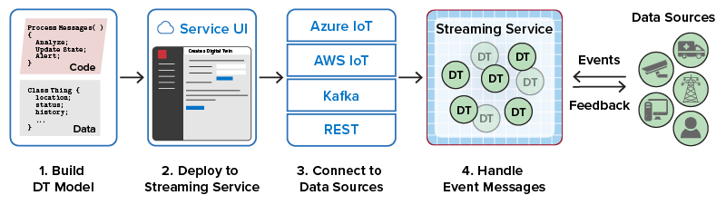
Digital Twin Development Process
Application developers create one or more digital twin models and deploy them to the hosting platform using the service’s UI.
For real-time analytics, connect to data sources using popular message hubs or REST.
For simulation, spawn initial digital twin instances and start simulation.
Use aggregate analytics to query and visualize state of digital twins.

Slide 42
ScaleOut Digital Twin Model
Overview of the ScaleOut Digital Twin Model
Real-Time Monitoring
Simulation
High-Level View of the APIs
Development Workbench
Sample Program
Sample Unit Test

Slide 43
Why Use Specific APIs for Digital Twins?
Simplifies application design; enable the creation of object-oriented digital twins independent of the details of the underlying in-memory platform, including:
Explicitly managing and accessing state objects in the IMDG
Orchestrating the staging of message-processing code across the IMDG
Connecting digital twins to data sources
Delivering messages to digital twins and back to data sources
Ensuring highly available message handling
Digital twin APIs and services allow the application to focus on:
Defining message-processing and simulation code for each type of data source
Defining the dynamic state information to be managed for each data source
Describing periodic data-parallel analytics to be performed across all digital twins of a given type

Slide 44
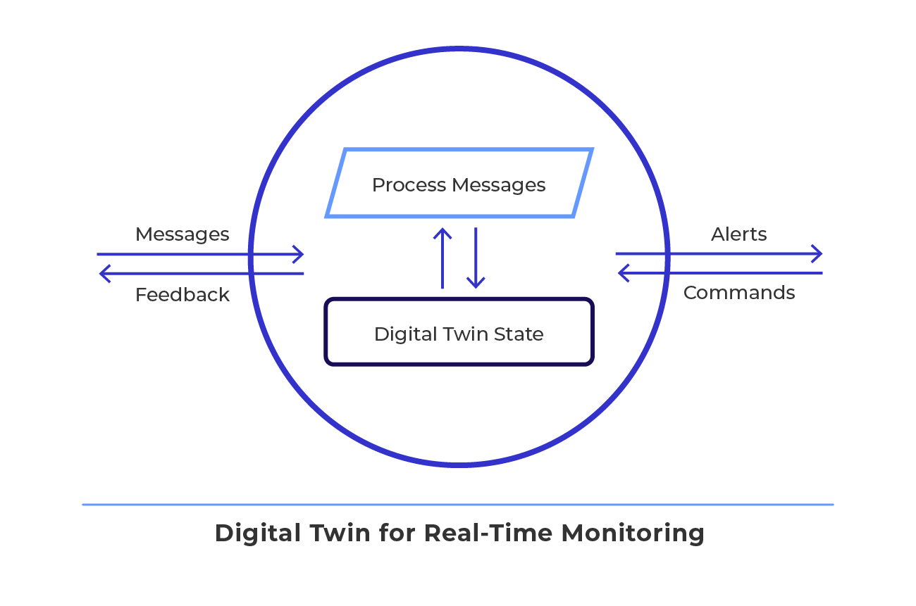
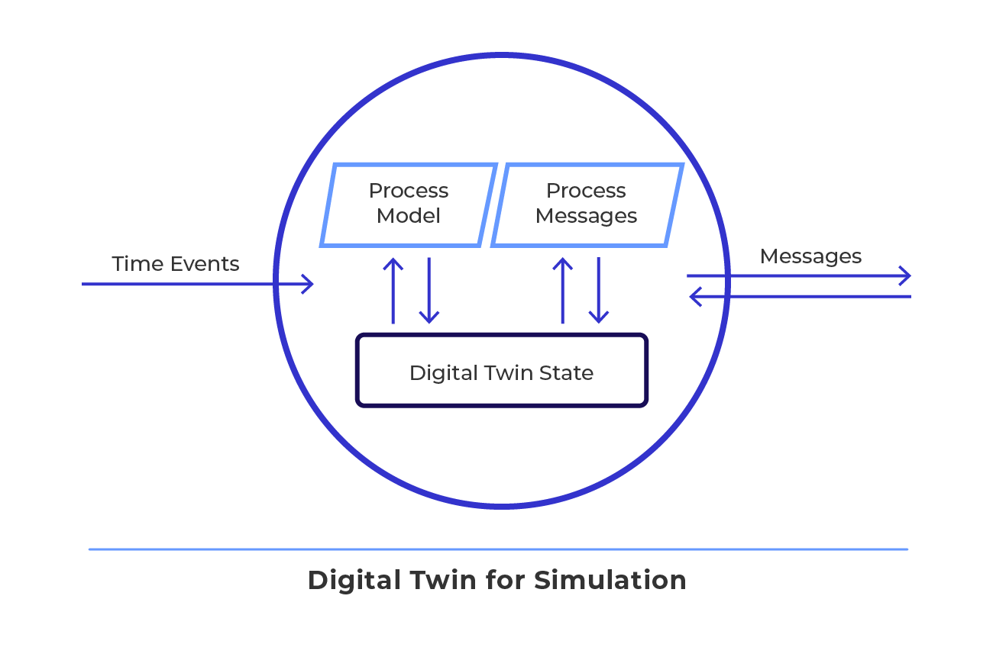
Creating and Hosting Digital Twins
Goals:
Use a simple, flexible software architecture for implementing digital twin models.
Leverage the inherent object-oriented nature of digital twins:
State information for each instance of a model
Common analytics for all instances (code, business rules, and machine learning)
Let the in-memory platform handle the rest:
Create and manage digital twin instances at scale.
Ensure fast access to digital twin state.
Enable real-time aggregate analytics (e.g., map-reduce and query) for digital twin state.

Slide 45
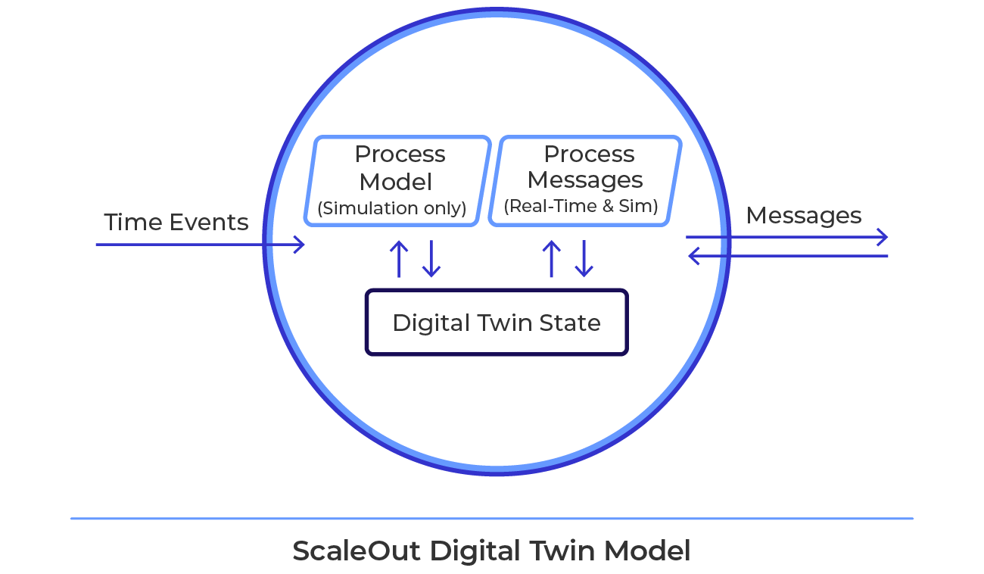
Anatomy of a Digital Twin
A digital twin model provides an integrated framework for both streaming analytics and simulation. For each device type, it consists of:
A message processing and optional simulation processing method:
Receives and analyzes live or simulated messages and simulation time events.
Encapsulates analysis algorithm (Java, C#, rules, ML, …).
Updates state information, generates outbound messages and alerts.
A state object, which holds dynamic data:
Context/metadata for analyzing events
Also: time-ordered event lists, cached parameters
One instance per data source or device
Notes:
ScaleOut has created what we call “real-time digital twin” technology. A RT DT is a model that consists of two main components:
First, a Message Processor handles incoming telemetry and has code to analyze the telemetry in light of dynamic state of the data source. The message processor also alerts or provides control signals based on its analysis.
Second, a state object holds the dynamic state of the data source. The state can be any metadata or context that is used by the message processor to evaluate the data source. That can include time-ordered event lists.
There is a RT DT instance for each data source; in other words, a one to one mapping. ScaleOut’s RT DT technology automatically creates a new RT DT instance the first time that telemetry is received from a new data source.
Again, the purpose of our RT DT technology is:
1. Track & compute device-specific information for real-time, deep introspection
2. Provide immediate feedback and alerting
3. Provide aggregate analysis across all data sources

Slide 46
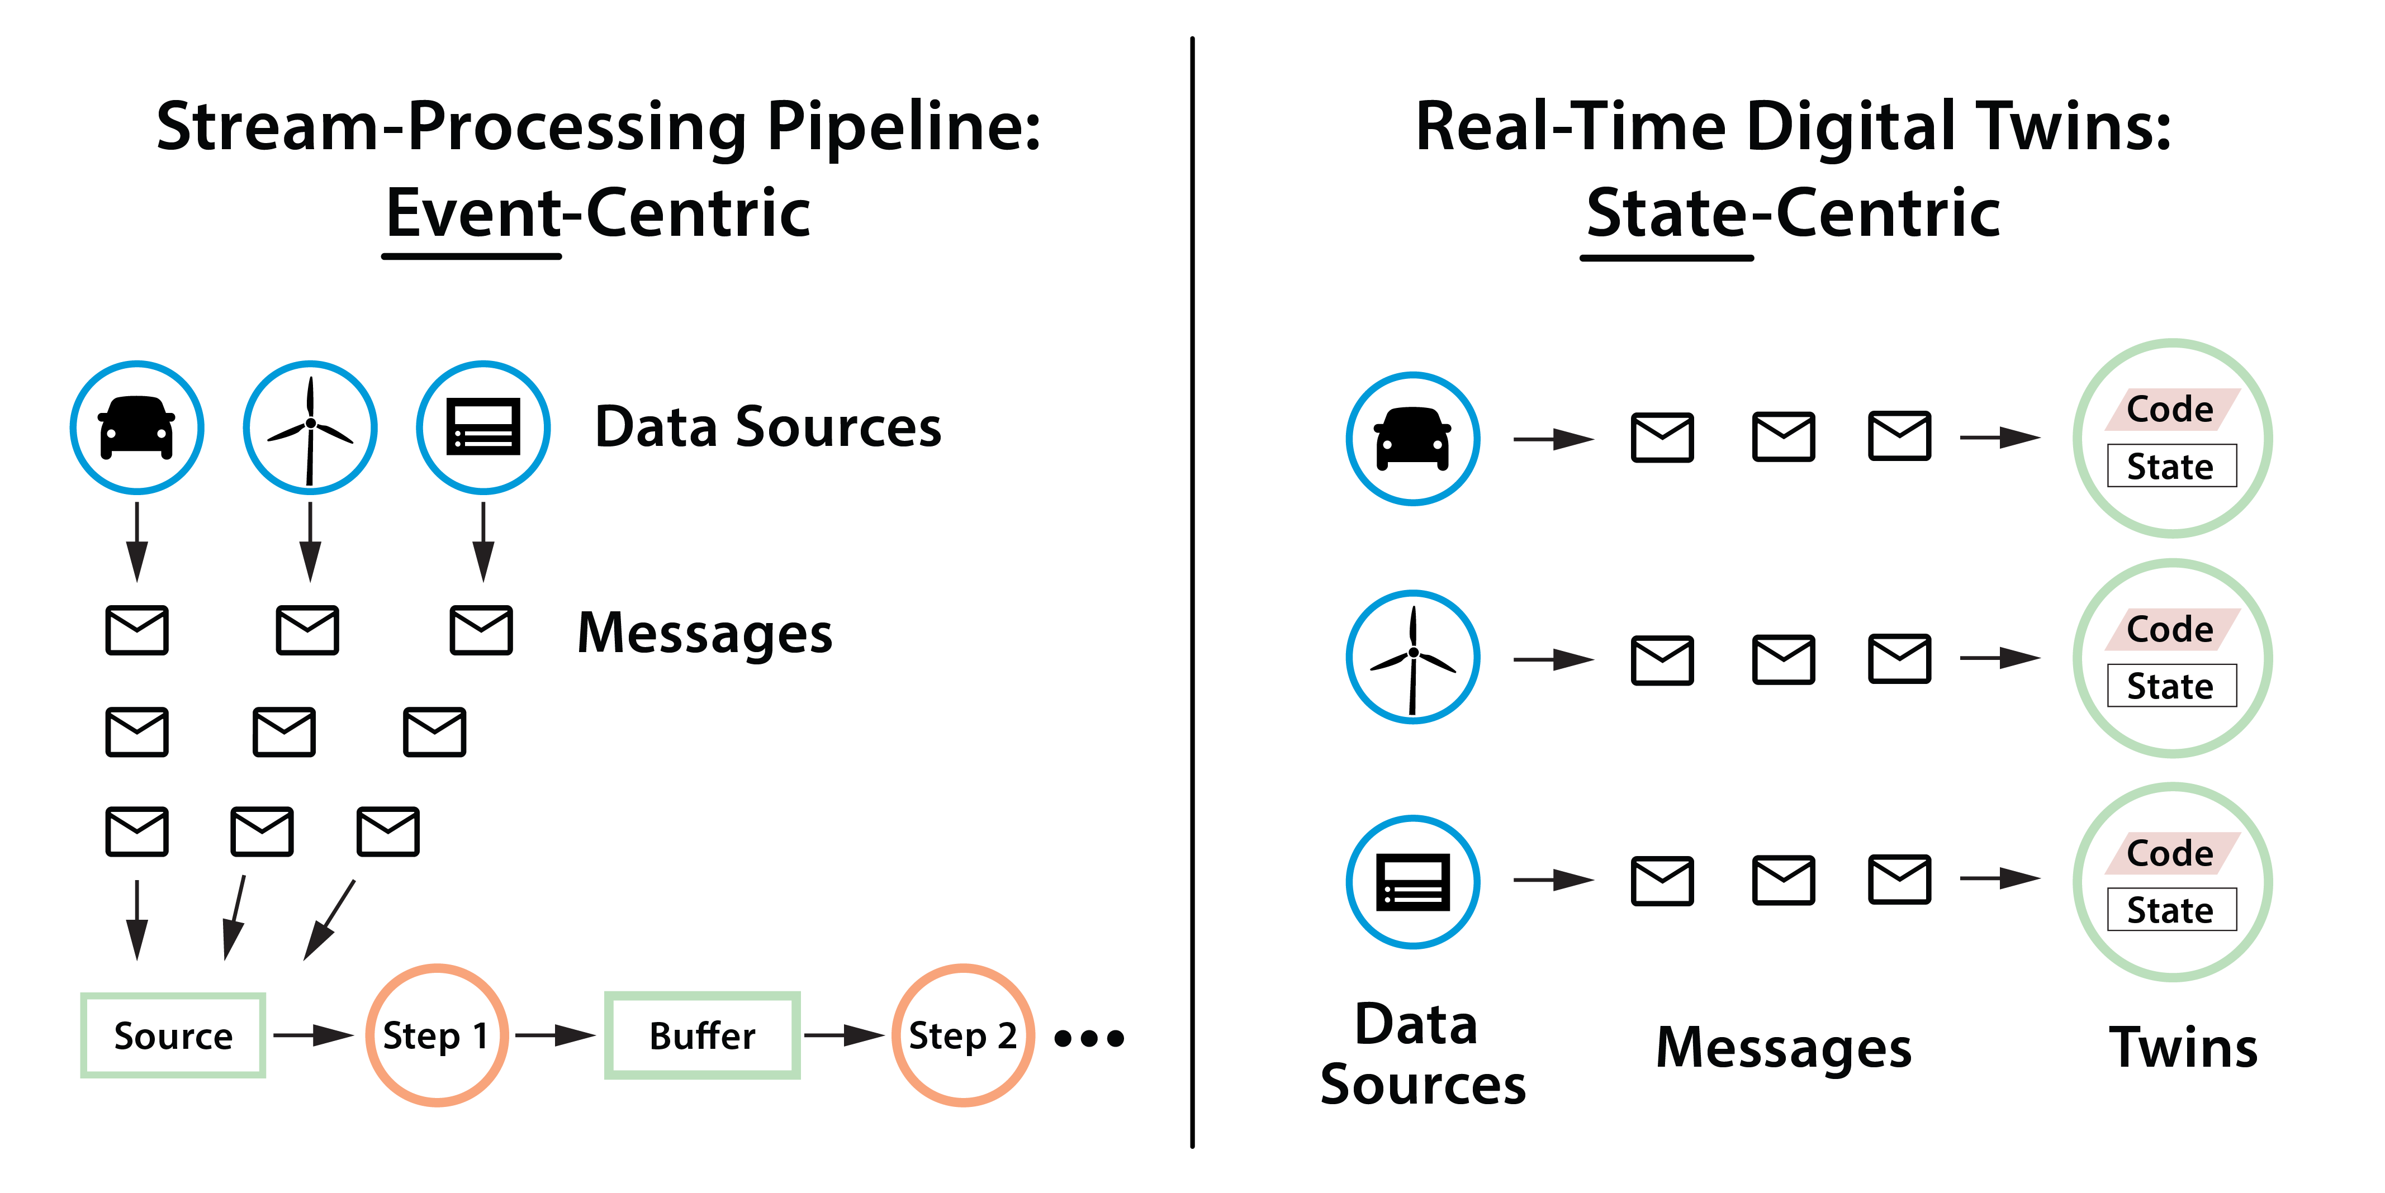
Digital Twins Simplify Application Design
State-centric approach (vs. event-centric) simplifies tracking of thousands of individual data sources:
Avoids event correlation in the application.
Avoids need for ad hoc state storage.
Encapsulates analysis logic in one place.
Provides automatic domain for aggregate analysis.

Slide 47
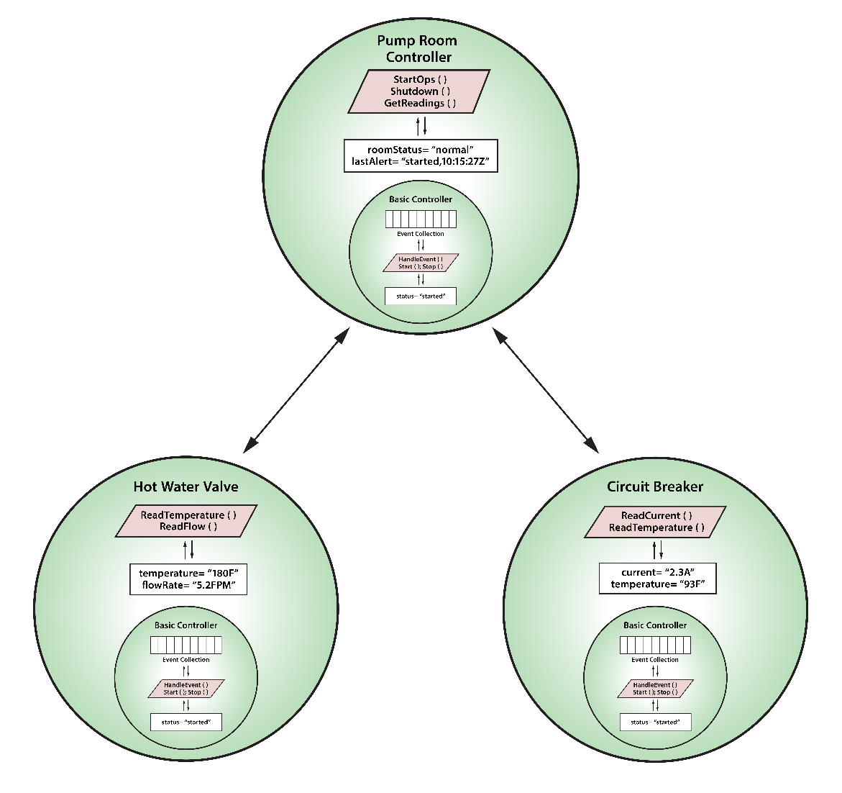
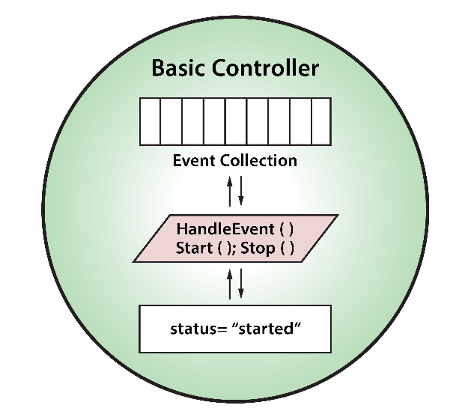
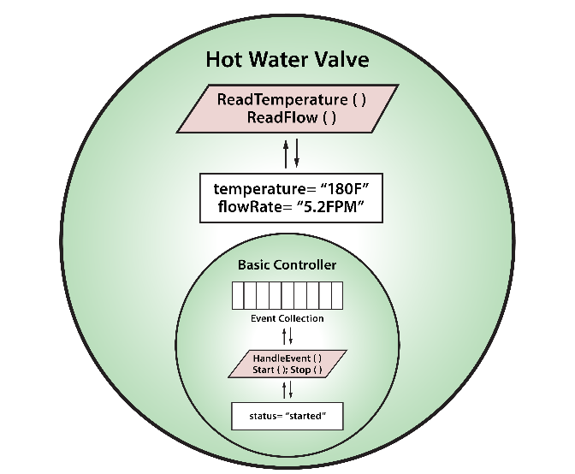
Digital Twins Are Object-Oriented
Digital twin objects can use inheritance to create specialized behaviors:
Instances of objects can be organized in a hierarchy:
IS A
Base Class
Sub-Class

Slide 48
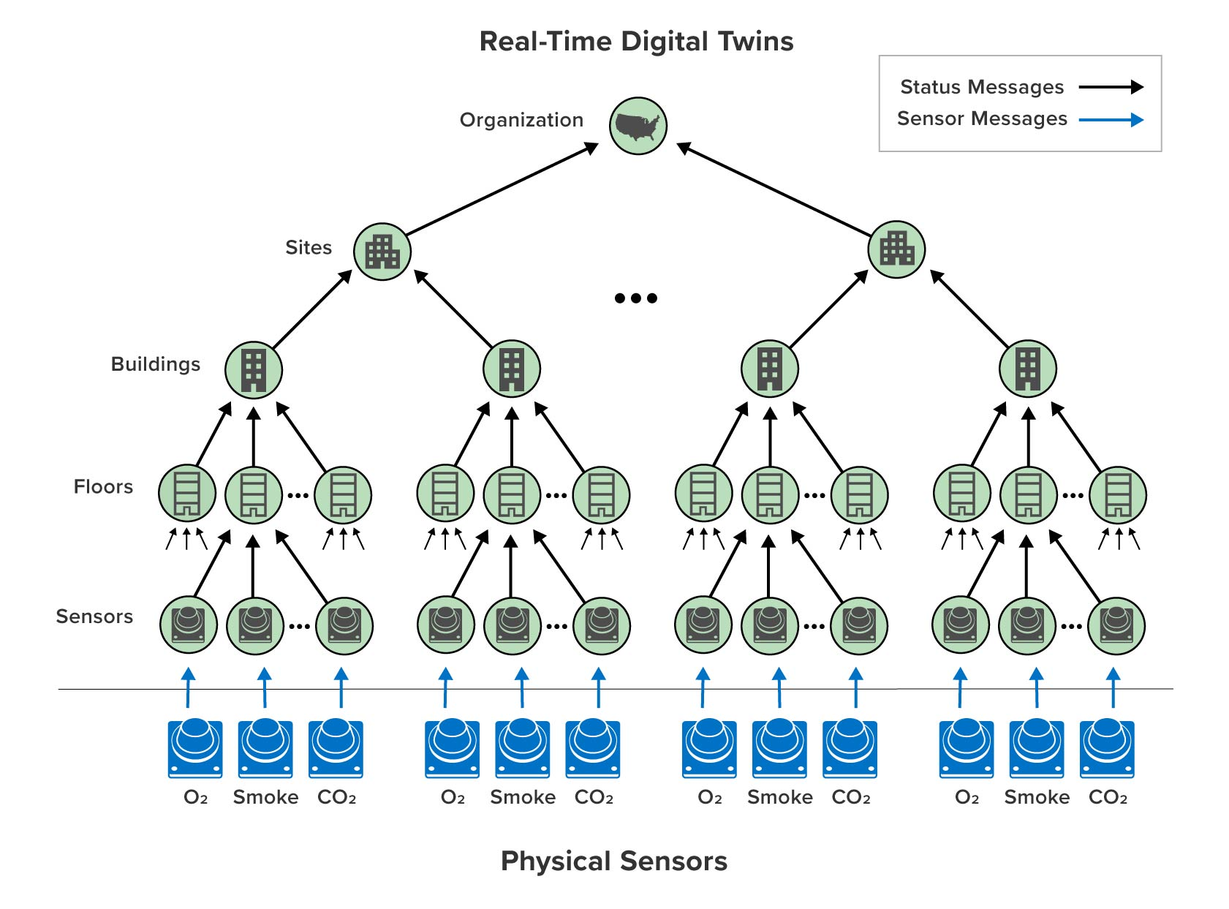
Digital Twins Can Organize in a Hierarchy
Track complex systems as hierarchy of digital twin objects:
Leaf nodes receive telemetry from physical endpoints.
Higher level nodes represent subsystems:
Receive telemetry from lower-level nodes.
Supply telemetry to higher-level nodes as alerts.
Allow successive refinement of real-time telemetry into higher-level abstractions.
Example: Hierarchy of Digital Twins for a Sensor Network

Slide 49
Build Digital Twins with Open-Source APIs
Application defines a message type for incoming messages.
Application implements a base class DigitalTwinBase to define a state object that holds instance properties and optional event lists.
Application implements a message and simulation processing methods: ProcessMessages(stateObject, processingContext, messageList) ProcessModel(stateObject, processingContext, nextSimTime)
ProcessingContext defines APIs for sending messages to data source or to other twins.
Message list contains an enumerable list of messages that arrived since last call to ProcessMessages.
Hides latency by handling multiple messages at once.
Enables single acknowledgment for a group of messages.

Slide 50
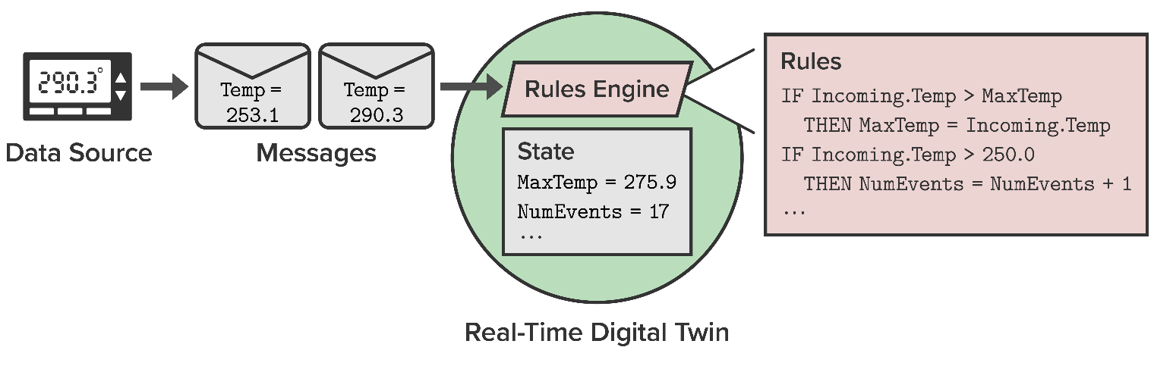
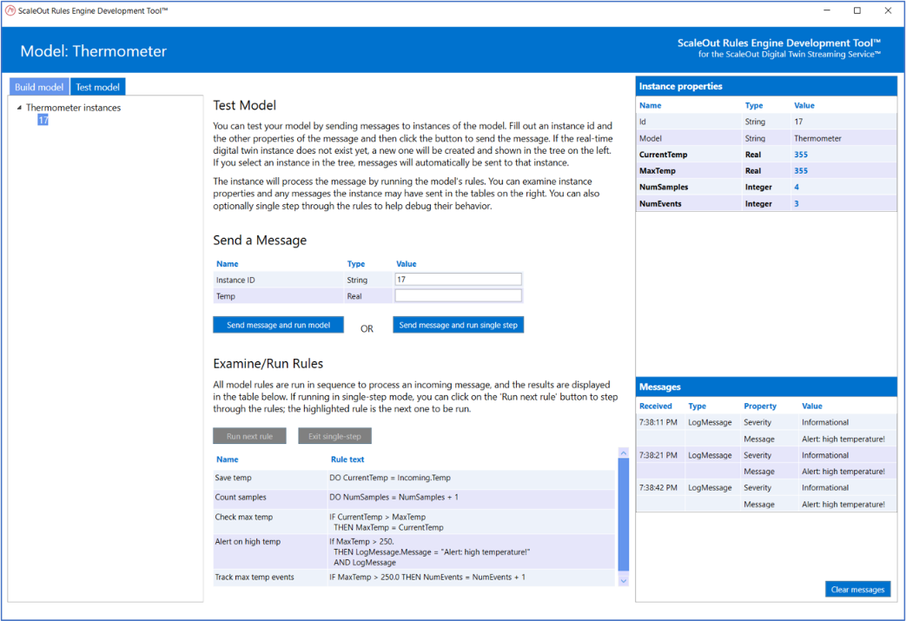
Optional Rules Engine Simplifies Design
Allows application code to be described as a sequence of rules:
Uses a simple “IF condition THEN action” rules language.
Avoids the need to use formal programming languages.
Desktop-based ScaleOut Model Development Tool enables fast development and testing.

Slide 51
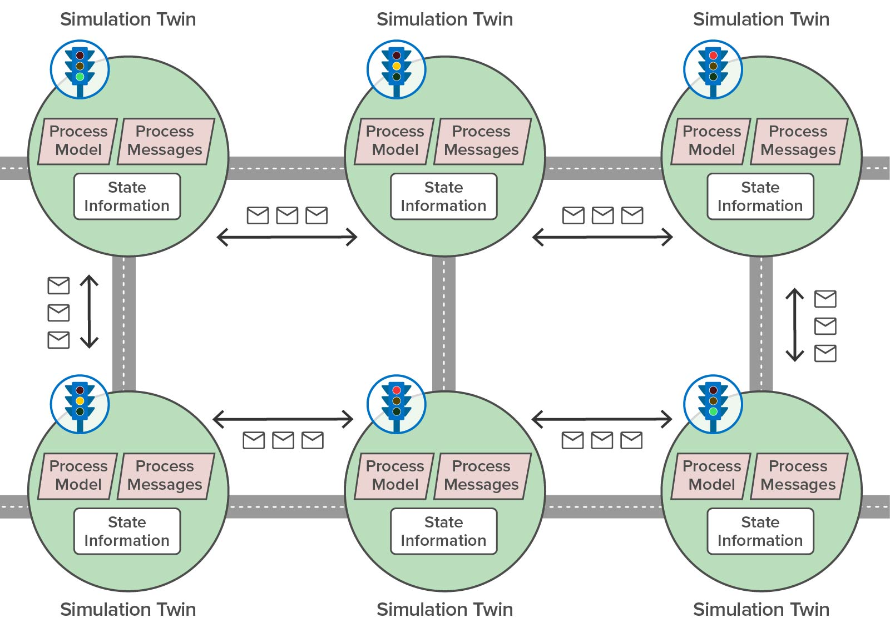
Implementing Digital Twin Simulations
User’s digital twin model implements:
State information to be maintained by each instance
A ProcessModel method that runs at each time step
A ProcessMessages method that handles incoming messages
ScaleOut’s in-memory platform:
Distributes digital twin instances across a server cluster.
Runs all instances at each time step.
Delivers and processes messages sent between instances.
Provides data visualization and query.
A Traffic-Flow Simulation

Slide 52
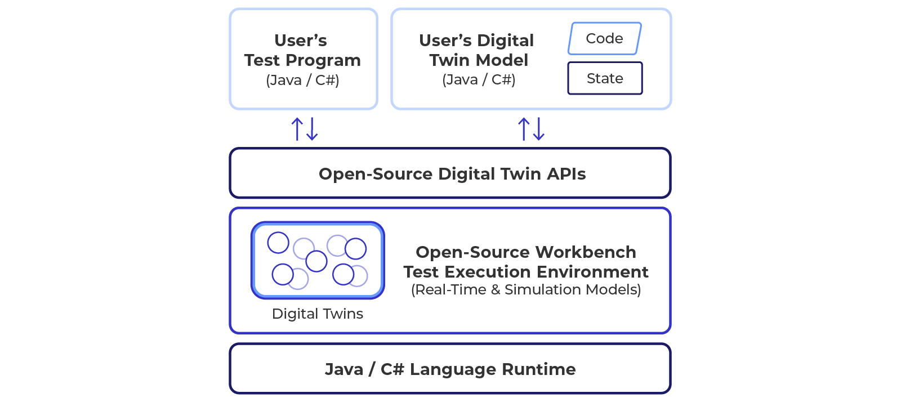
Development Workbench
Debugging and test within the cloud service can be challenging.
Cannot set breakpoints and examine state.
Difficult to verify all code paths.
Workbench environment allows development and test on developer’s workstation:
Uses same base classes as production deployment.
Replaces ProcessingContext with mock version.
Deploys model with same APIs as used on-premises.
Allows sending/receiving messages from instances.
Allows instance state to be examined.

Slide 53

A software framework for building digital twin applications and a fast, scalable hosting platform:
Runs in the Azure cloud or on-premises
Includes development tools in C#, Java, using business rules and machine learning.
Hosts digital twins on ScaleOut’s patented, in-memory computing platform.
Has a UI for control, query, and visualization of aggregate analytics.
Connects to messaging hubs, Kafka, etc.

Slide 54

Digital Twins are Part of a Cloud Ecosystem
ScaleOut Digital Twins adds real-time analytics, visualization, and query to Azure Digital Twins.
Azure Digital Twins use all existing tools for visualization and batch analysis.
Thermostat Example Running in the Azure Digital Twins Ecosystem

Slide 55


Transparent Migration to the Edge
Real-time digital twins can naturally be organized into hierarchies.
As edge computing becomes more capable, low-level real-time digital twins can migrate from a cloud service to edge containers:
Avoids programming changes and enables a uniform development model.
Allows division of labor between edge (device specific) and cloud (strategic).
Reduces message traffic.
Migrate to Edge

Slide 56

Example: Simulated Power Grid
Goal: Demonstrate value of enhanced situational awareness
Overview:
Simulates 20K nodes within a power grid spanning the US and subject to outages or attack.
Each node streams telemetry with its status to its real-time digital twin in the cloud service.
Real-time twin evaluates telemetry and updates derived state: alert level:
Assesses threat level for that node (range 0-20)
Updated by examining telemetry with knowledge of node’s function and reporting history (e.g., false positives)

Slide 57

Implementation of a Simulated Power Grid
Application code is dramatically simplified:
Developer just implements one message processing method and state object for a single real-time digital twin.
Approximately 20 Java statements in this demonstration
Platform automatically runs this code for all data sources.
Automatically correlates incoming messages by data source.
Automatically scales to handle large workloads.
Developer avoids:
Selecting telemetry out of a single, combined event stream
Creating ad hoc storage for contextual data
Pushing the data into a data lake for offline analysis using Spark

Slide 58
Power Grid Demo Code
Definition of state object (Java):
public class StatusTracker extends DigitalTwinBase {
// State variables
public String node_type;
public String node_condition;
public String region;
public double longitude;
public double latitude;
// Derived state variables
public int alert_level;
public int minorIncidentCount;
public int moderateIncidentCount;
public int falseIncidentCount;
public int severeIncidentCount;
public int totalIncidents;
public int totalResolvedIncidents;
public boolean experiencingIncident;
// Dynamic incident report list
public List<IncidentReport> incidentList;}

Slide 59
Power Grid Demo Code
Sample message-processing code (Java):
public ProcessingResult processMessages(ProcessingContext processingContext, StatusTracker digitalTwin,
Iterable<StatusTrackerMessage> messages) throws Exception {
// Iterate through the incoming messages:
for(StatusTrackerMessage msg : messages) {
// if the message indicates a moderate incident and this tracker has never had a severe
// incident while the heuristic false incident ratio is greater than 50%, boost the alert level:
if(msg.moderateIncident() &&
digitalTwin.getSevereIncidentCount() == 0 &&
digitalTwin.getModerateIncidentCount() > 0 &&
((double)(digitalTwin.getFalseIncidentCount()/
digitalTwin.getModerateIncidentCount()) >= 0.5)) {
digitalTwin.setAlertLevel(Constants.MODERATE+3);
digitalTwin.incrementModerateEventCount();
digitalTwin.setStatusTrackerCondition(msg.getNodeCondition());
}
// ... [additional rules]
}
return ProcessingResult.UpdateDigitalTwin;}

Slide 60
Aggregate Analytics in the Demo
Aggregate analysis by the cloud service quickly pinpoints emerging threats for managers:
Evaluates alert level in digital twin state for all nodes and aggregates results.
Dashboard widgets display maximum alert level by region.
Runs every 5-10 seconds as a background MapReduce job.

Slide 61


Key Takeaways
Digital twins aren’t just for PLM.
They offer a powerful software architecture for real-time streaming analytics and simulation of large systems.
Numerous applications in diverse verticals can benefit:
Transportation
Logistics
Disaster Recovery
Many more
In-memory computing provides a key enabling technology:
Fast responses
Transparent scaling
Aggregate analytics
Real-time visualization

Slide 62
DEMO: Security Tracking for a Simulated Nationwide Power Network

Slide 63
BREAK

Slide 64
Session 2: Build a Digital Twin Model
Build/Demo a Simple Model for Real-Time Monitoring:
Get your laptops ready; use C# or Java or business rules (or get the code from us).
Download the digital twin APIs and workbench.
Build the model.
Write a unit test.
Test with the workbench.
DEMO: Building a Wind Turbine Model and Connecting to Live Data Sources on Microsoft Azure
Resources:
ScaleOut Digital Twins Docs: https://www.scaleoutdigitaltwins.com/developers#docs
C#:
API libraries: https://github.com/scaleoutsoftware/DigitalTwinCore-dotnet
Workbench NuGet package: https://www.nuget.org/packages/Scaleout.DigitalTwin.Workbench
Java:
API libraries and Workbench: https://github.com/scaleoutsoftware/JavaDigitalTwinCore
Workbench Maven package: https://repo.scaleoutsoftware.com
Model Development Tool (Business Rules): https://www.scaleoutsoftware.com/pkg/ScaleOut.ModelDevTool.msi
Samples: https://github.com/scaleoutsoftware/DigitalTwinSamples

Slide 65

Sample: Smart Gas Sensor Digital Twin
Natural gas typically consists of methane (or ethane), propane and other elements. This gas is an extremely fast-acting, toxic substance. The maximum allowable short-term exposure level is 50 ppm for 15 minutes
Programming Exercise:
Create a digital twin model to process telemetry from a gas sensor for tracking gas concentration and alerting when maximum exposure has been reached.
Create messages which report the id, current ppm, and timestamp for a gas sensor.
Set an alert flag when either the gas level exceeds 50 ppm for more than 30 seconds or the level spikes to 200 ppm.
(Bonus task): in addition to setting the flag add the code for sending a pipe shutdown control message back to the meter device using the SendToDataSource method.

Slide 66
Defining the Digital Twin Model
Create a digital twin model.
A digital twin model defines the state properties for each instance and the message/simulation code for all instances.
Step 1: Define the state properties for each instance:
Instance ID
Location
Current ppm
Time of earliest reading > 50 ppm while readings > 50 ppm
Alert condition (normal or alerted)
Step 2: Define message properties:
Model name
Instance ID
Ppm
Time
Step 3: Define message processing code:
Capture latest ppm reading and time.
Capture time of earliest ppm > 50 while readings are > 50.
Determine whether the latest ppm reading triggers an alert.

Slide 67
Digital Twin APIs (C#)
Instance properties are defined as a subclass of the digital twin base class:
public class GasSensorTwin : DigitalTwinBase
{
public bool Alerted { get; set; }
}
User-defined message type defines message properties:
public class GasMessage {
public int Ppm { get; set; }
public DateTime Timestamp { get; set; }
}
Model’s code are defined as a subclass of the MessageProcessor class that overrides the ProcessMessages method:
public class GasSensorTwinMsgProcessor : MessageProcessor<GasSensorTwin, GasMessage>
{
public override ProcessingResult ProcessMessages(ProcessingContext context,
GasSensorTwin dt,
IEnumerable<GasMessage> newMessages)
{
...
}
}

Slide 68
The GasSensorTwin Properties
Properties that are unique to each digital twin for its specific gas sensor:
public class GasSensorTwinModel : DigitalTwinBase
{
// Constants:
public const int MaxAllowedPPM = 50;
public static TimeSpan MaxAllowedTimePeriod = TimeSpan.FromSeconds(30);
public const int SpikeAlertPPM = 200;
// Properties:
public int LastPPMReading { get; set; }
public DateTime LastPPMTime { get; set; }
public bool LimitExceeded { get; set; }
public DateTime LimitStartTime { get; set;
public int AlarmSounded { get; set; } // alerted state is 1, normal is 0
}

Slide 69
The GasSensorTwin Algorithm
Message-processing code for all digital instances of the model:
dt.LastPPMReading = msg.PPMReading; dt.LastPPMTime = msg.Timestamp;
if (msg.PPMReading > GasSensorTwinModel.MaxAllowedPPM)
{
if (!dt.LimitExceeded)
{
dt.LimitExceeded = true; dt.LimitStartTime = dt.LastPPMTime;
}
if ((dt.LastPPMTime - dt.LimitStartTime) > GasSensorTwinModel.MaxAllowedTimePeriod ||
msg.PPMReading >= GasSensorTwinModel.SpikeAlertPPM)
{
dt.AlarmSounded = 1; // bonus code: context.SendToDataSource(action);
}
}
else
{
dt.AlarmSounded = 0; dt.LimitExceeded = false;
}

Slide 70
Test the Model with the Workbench
Write and run a test program:
Create a “real-time” workbench and add the model’s message processor:
using RealTimeWorkbench wb = new RealTimeWorkbench();
var endpoint = wb.AddRealTimeModel(“GasSensorTwin", new GasMsgProcessor());
Send message(s) to the workbench:
var msg = new GasMessage
{
Ppm = 20,
Timestamp = DateTimeOffset.Now
};
endpoint.Send(“Sensor1", msg);
Validate instance properties:
var gasInstances = wb.GetInstances<GasSensorTwinModel>(“GasSensorTwin");
var gasSensor1 = rtInstances[“Sensor1"];
Assert.Equal(20, gasSensor1.Ppm);

Slide 71
DEMO: Downloading the APIs and Workbench and Building the Gas Sensor Model

Slide 72
DEMO: Building the Unit Tests and Using the Workbench

Slide 73



DEMO: A Digital Twin for a Wind Turbine
Automatically correlates telemetry from each data source.
Immediately accesses and tracks dynamic, device-specific state for each wind turbine; for example:
Knows turbine’s model characteristics, service history and requirements (e.g., time until next service).
Tracks recent events (e.g., overtemp/overspeed events).
Introspects and alerts in real time on derived device-specific state information; for example:
Tracks frequency and duration of overtemp/overspeed alerts and adjusts feedback based on dynamic analysis.
Adjusts time to alerting based on model & characteristics.
Adjusts time to alerting if service is upcoming (higher likelihood of unexpected failure).
Scales for 1000s of devices without database & network delays.
Jul 22, 2019

Slide 74

Sample Application with Code (C#)
Goal: Illustrate use of digital twin to analyze temperature telemetry from a wind turbine.
Digital twin tracks:
Parameters: model, pre-maintenance period based on model, max. allowed temperature, max. allowed over-temp duration (normal and pre-maintenance)
Dynamic state: time to next maintenance, over-temp condition and its duration
Message processing:
Determines onset of and recovery from over-temp condition
Alerts at maximum allowed duration based on normal and pre-maintenance conditions
Logs incidents for time-windowing analysis
Block Island Wind Farm

Slide 75
Sample State Object (C#)
public class WindTurbine : DigitalTwinBase
{
// physical characteristics:
public const string DigitalTwinModelType = "windturbine";
public WindTurbineModel TurbineModel { get; set; } = WindTurbineModel.Model7331;
public DateTime NextMaintDate { get; set; } = new DateTime().AddMonths(36);
public const int MaxAllowedTemp = 100; // in Celsius
public TimeSpan MaxTimeOverTempAllowed = TimeSpan.FromMinutes(10);
public TimeSpan MaxTimeOverTempAllowedPreMaint = TimeSpan.FromMinutes(2);
// dynamic state variables:
public bool TrackingOverTemp { get; set; }
public DateTime OverTempStartTime { get; set; }
public int NumberMsgsWithOverTemp { get; set; }
// list of incidents and alerts:
public List<Incident> IncidentList { get; } = new List<Incident>();
}

Slide 76
Sample Message Processor (Outer Loop)
public override ProcessingResult ProcessMessages(ProcessingContext context,
WindTurbine dt, IEnumerable<DeviceTelemetry> newMessages)
{
var result = ProcessingResult.NoUpdate;
// determine if we are in the pre-maintenance period for this wind turbine model:
var preMaintTimePeriod = _preMaintPeriod[dt.TurbineModel];
bool isInPreMaintPeriod = ((dt.NextMaintDate
- DateTime.UtcNow) < preMaintTimePeriod) ? true : false;
// process incoming messages to look for over-temp condition:
foreach (var msg in newMessages) {
// if message reports a high temp indication, track it:
if (msg.Temp > WindTurbine.MaxAllowedTemp)
<track over-temp condition>
else if (dt.TrackingOverTemp)
<resolve over-temp condition>
}
return result;}

Slide 77
Track or Resolve Over-Temp Condition
// track over-temp condition:
{dt.NumberMsgsWithOverTemp++;
if (!dt.TrackingOverTemp) {
dt.TrackingOverTemp = true; dt.OverTempStartTime = DateTime.UtcNow;
<add a notification to the incident list> }
TimeSpan duration = DateTime.UtcNow - dt.OverTempStartTime;
// if we have exceeded the max allowed duration for an over-temp, send an alert:
if (duration > dt.MaxTimeOverTempAllowed ||
(isInPreMaintPeriod && duration > dt.MaxTimeOverTempAllowedPreMaint)) {
var alert = new Alert(); <fill out the alert message>;
context.SendToDataSource(Encoding.UTF8.GetBytes(JsonConvert.SerializeObject(alert)));
<add a notification to the incident list> }}
// resolve the condition and reset our state:
{dt.TrackingOverTemp = false; dt.NumberMsgsWithOverTemp = 0;
<add a notification to the incident list> }

Slide 78
DEMO: Testing the Wind Turbine Model with Live Data Sources

Slide 79
BREAK

Slide 80
Session 3: Simulation & Aggregate Analytics
See a brief tour of the ScaleOut Digital Twins UI:
Deploying and Managing a Model
Connecting to the Data Sources
Creating a Widget to Visualize Aggregate Statistics
Querying the Model for Detailed Information
VIDEO: Preview of Upcoming ScaleOut Digital Twins UI
Download and install the evaluation package:
Windows: https://static.scaleoutsoftware.com/pkg/ScaleoutDigitalTwinsEvalWindows.zip
Linux: https://static.scaleoutsoftware.com/pkg/ScaleoutDigitalTwinsEvalLinux.zip
Run the gas sensor twin model and the simulated gas sensor model in simulation.
Use a csv file to create 100 digital twin instances for each model.
Instances have latitude/longitude at four sites.
Learn about aggregate analytics.
Create a widget and find issues with gas sensors (if any).

Slide 81

Deploying a Digital Twin
Model is first created using APIs.
UI uploads code from a zip file which contains dll’s for all dependencies and metadata for the model.
UI selects language runtime: Java, .NET (C#), or Rules.

Slide 82

Deploying a Connector to the Cloud
Connectors can be created by specifying the hub type and connection parameters.
Hub types include:
Azure IoT Hub
AWS Core
Azure Kafka
REST is accessed using a URL.

Slide 83

Managing Digital Twin Models
Each model can be independently managed to check status and restart as necessary:

Slide 84

Examining a Digital Twin Instance
The properties for each digital twin instance (i.e., for each device) can be examined:

Slide 85
DEMO: Installing the Evaluation Package

Slide 86

How Simulation Works
Each digital twin implements a time-driven simulation model for an entity.
The platform sends a message to process the model at each simulated time step.
The instances determine the next simulated time step to run.
Can inject delays.
Digital twins can exchange messages during each time step.
Execution of the simulation can:
Use a desired granularity for time steps.
Run at a selected speed relative to real time.

Slide 87
The SimulatedGasSensor Properties
Properties that are unique to each digital twin for its specific gas sensor:
public class SimulatedGasSensorTwinModel : DigitalTwinBase
{
// Properties:
public int CurrentPPMValue { get; set; } = 0;
public int NumberOfSimIterations { get; set; } = 0;
public SensorStatus SensorStatus { get; set; }
public string Site { get; set; }
}

Slide 88
The SimulatedGasSensor Algorithm
Model-processing code for all digital instances of the model:
if (digitalTwin.SensorStatus == SensorStatus.Alarmed)
{
simulationController.Delay(TimeSpan.FromSeconds(30));
digitalTwin.SensorStatus = SensorStatus.Active;
}
else
{
var currentPPMValue = ProducePPMValue(digitalTwin);
digitalTwin.CurrentPPMValue = currentPPMValue;
var telemetry = new GasSensorTelemetry()
{
PPMReading = currentPPMValue, Timestamp = DateTime.UtcNow
};
SendingResult res = context.simulationController.EmitTelemetry("GasSensorModel",
telemetry);}

Slide 89
The SimulatedGasSensor Algorithm
Model-processing code helper function:
public int ProducePPMValue(SimulatedGasSensorModel digitalTwin)
{
int result = 0;
switch (digitalTwin.Site)
{
case "Seattle":
case "Los Angeles":
result = Random.Shared.Next(10, 45);
break;
case "Miami":
result = Random.Shared.Next(45, 199);
break;
case "New York":
result = Random.Shared.Next(210, 250);
break;
}
return result;
}

Slide 90
The SimulatedGasSensor Algorithm
Message-processing code for all digital instances of the model:
switch (message)
{
case DeviceCommand controlMessage:
if (controlMessage.Code == 100)
digitalTwin.SensorStatus = SensorStatus.Alarmed;
break;
}

Slide 91

Managing a Simulation Using the UI
When starting a simulation, specify the granularity of time steps and speedup relative to real time.

Slide 92


Aggregate Analysis
Goal: to quickly find issues across a large set of dynamically changing data:
Example: Where are gas sensors triggering alarms?
How widespread is the problem and how is it evolving?
How: Aggregate a digital twin’s property value across all instances and group by the value of another property.
Example: Show the number of alarmed gas sensors by site.
Examples of Aggregate Analysis for a Contact Tracing Application

Slide 93

How Aggregate Analysis Works
Uses a well known, data-parallel algorithm called “MapReduce”.
Similar to a “pivot table”
Typically run offline in “big data” platforms.
In-memory storage of digital twins allows it to run concurrently with message processing.
Automatically aggregates data stored in all digital twins for a specific model.
Digital twin state objects
Aggregated results
MapReduce Data Flow

Slide 94


Collecting Aggregate Statistics
“Widgets” can be created for digital twin models to display aggregate statistics:
Combines a selected state property by group.
Runs every few seconds.

Slide 95

Querying Real-Time Digital Twin Instances
Instances can be queried using a simplified, UI-based version of SQL SELECT.
The number of records returned can be limited.
Runs in a few seconds.

Slide 96
DEMO: Building and Running a Simulation for Workload Generation

Slide 97
DEMO: Running Aggregate Analytics with the Evaluation Package

Slide 98
Wrap-Up
Digital twins:
Are not just for PLM.
Can implement real-time monitoring and predictive modeling for large systems.
Can simplify software development with object-oriented APIs.
Can be hosted in memory for fast, scalable performance.
Can boost situational awareness with aggregate analytics and visualization.
Can analyze and respond to events in milliseconds.
Can seamlessly scale to track/model systems with many entities.
Can be applied to a wide range of use cases.

Slide 99
Thank you for joining us today. We hope you enjoyed the session!
To learn more, visit us at:
www.scaleoutdigitaltwins.com
Documentation is posted at:
https://www.scaleoutdigitaltwins.com/developers#docs
The slides and demos are posted at:
https://github.com/scaleoutsoftware/DigitalTwinSamples

Slide 101

Azure Digital Twins Integration
Adds real-time analytics with machine learning to Azure digital twins.
Benefits:
Allows Azure digital twins to process messages with low latency and at scale (removes resource limits).
Enables Azure digital twins to use machine learning with ML.NET to analyze telemetry.
Provides continuous data aggregation and visualization to enhance situational awareness.
Simplifies application design by avoiding the need for serverless functions and Event grid.
What It Does:
Adds a real-time component to every Azure digital twin.
Processes messages using ScaleOut’s in-memory computing platform.

Slide 102

Azure Digital Twins Integration
How It Works:
Each Azure digital twin has a corresponding real-time digital twin (RTDT).
RTDT defines properties used in message processing.
RTDT processes messages for its Azure digital twin.
Each Azure digital twin hosts properties defined by its RTDT.
RTDT defines a component in the Azure digital twin to store “real-time” properties.
ScaleOut Model Generator Tool automatically generates Azure digital twin’s component.
RTDT automatically retrieves and persists property values in its Azure digital twin.
Telematics Example of Azure Digital Twins Integration

Slide 103


Azure Digital Twins Integration APIs
Real-time digital twins can use APIs to read and update properties in other Azure digital twins that avoid the need for serverless functions.
Example of thermostat (from Microsoft tutorial) shows how RTDT can perform the work of serverless functions and Event Grid.
Thermostat Example with Serverless Functions
Thermostat Example with Real-Time Digital Twin

